Slide 1
Eleven Great
Modern Migrations

Slide 2
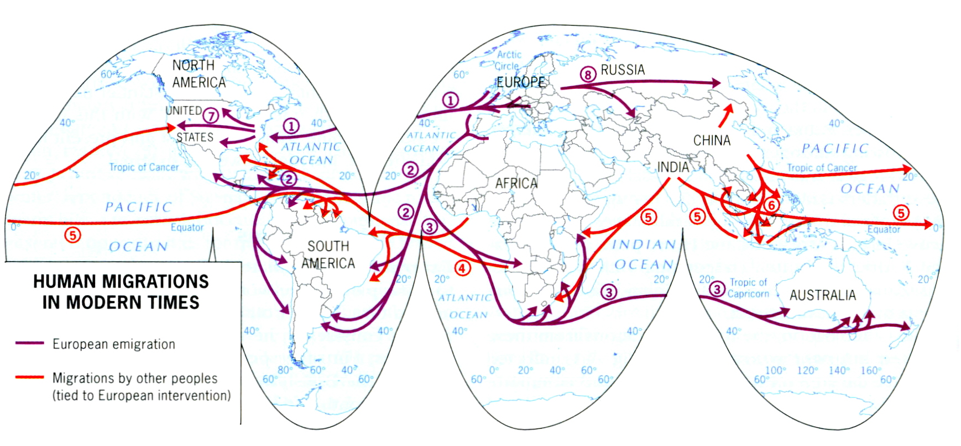

Slide 3
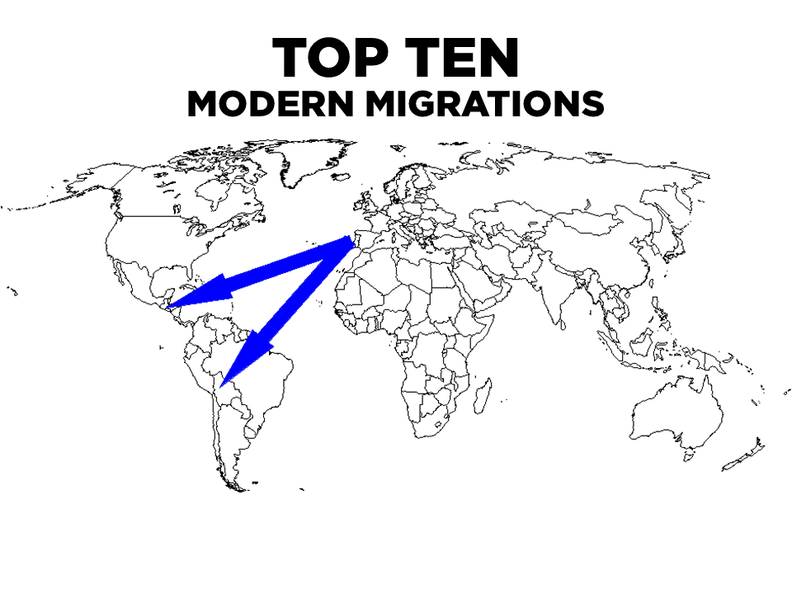
TOP ELEVEN

Slide 4
From Iberia to Central America & South America
Portuguese to Brazil
Spanish to the others
Large Mestizo population created
Exception: Indian countries such as Bolivia, Peru, Guatemala, etc.
Economic Success
Climate & Farming Methods

Slide 5
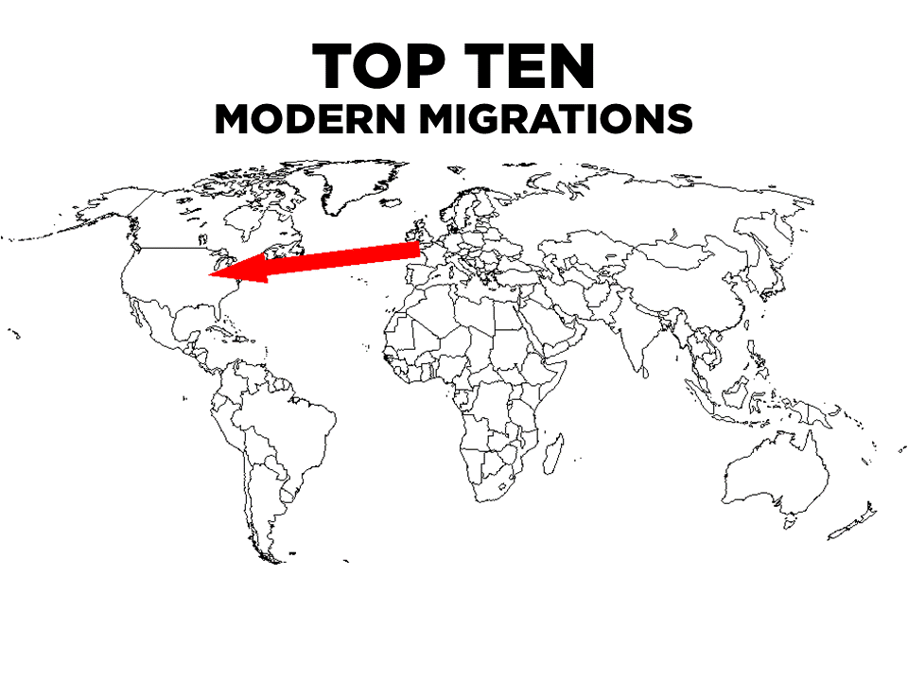
TOP ELEVEN

Slide 6
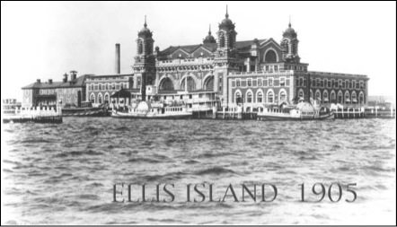
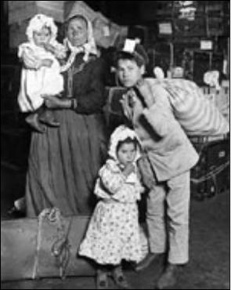
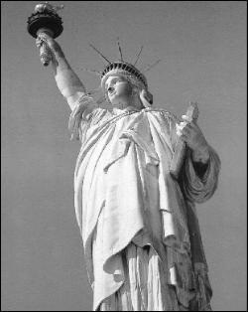
From Europe to North America
Pilgrims, Puritans, etc. (Mainly English at first)
Largest numbers overall were German
Beginning of the 20th century southern and eastern Europeans
…Also reservations for Indians

Slide 7
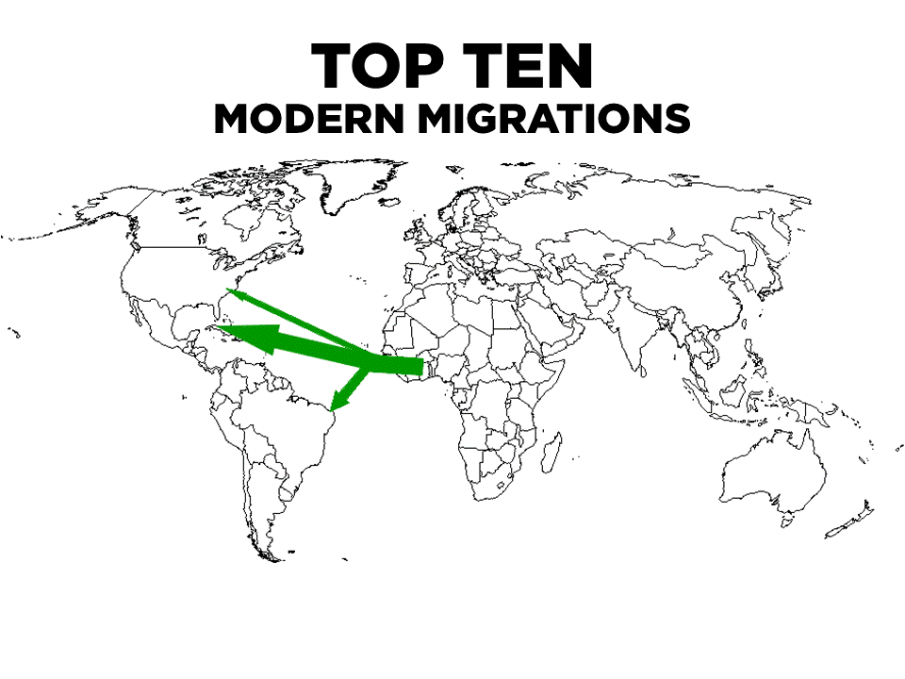
TOP ELEVEN

Slide 8
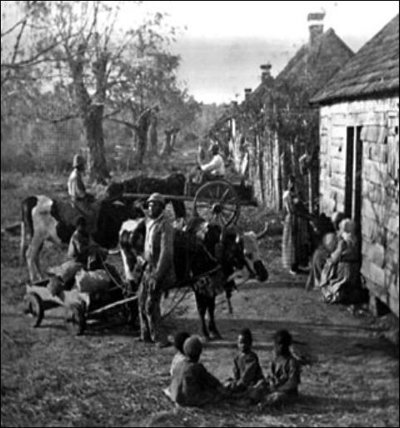
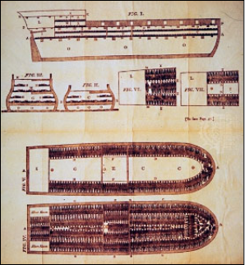
From West Africa to Brazil, Southern United States, and the Caribbean
Slavery
Haiti, Jamaica, and Trinidad are largely African countries
Brazil’s coastal cities

Slide 9
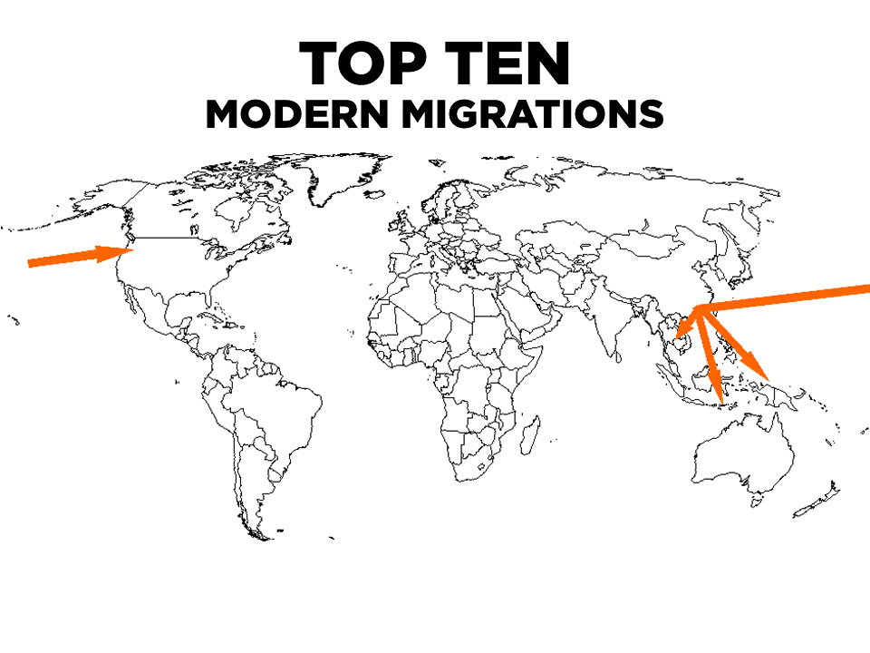
TOP ELEVEN

Slide 10
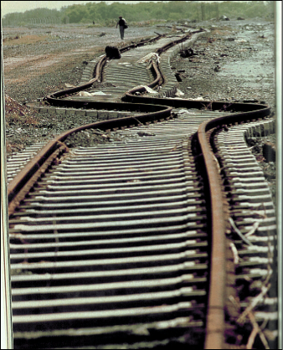
From China to Southeastern Asia, West United States
Singapore is a Chinese country which began as a trading outpost
Vancouver, BC and San Francisco have huge Chinatowns
Textile Manufacturing
Construction
Chinese worked on U.S. west coast building first railroad to span across the United States, 1869
Notes:
Chinese worked on U.S. west coast building first railroad to span across the United States 1869

Slide 11
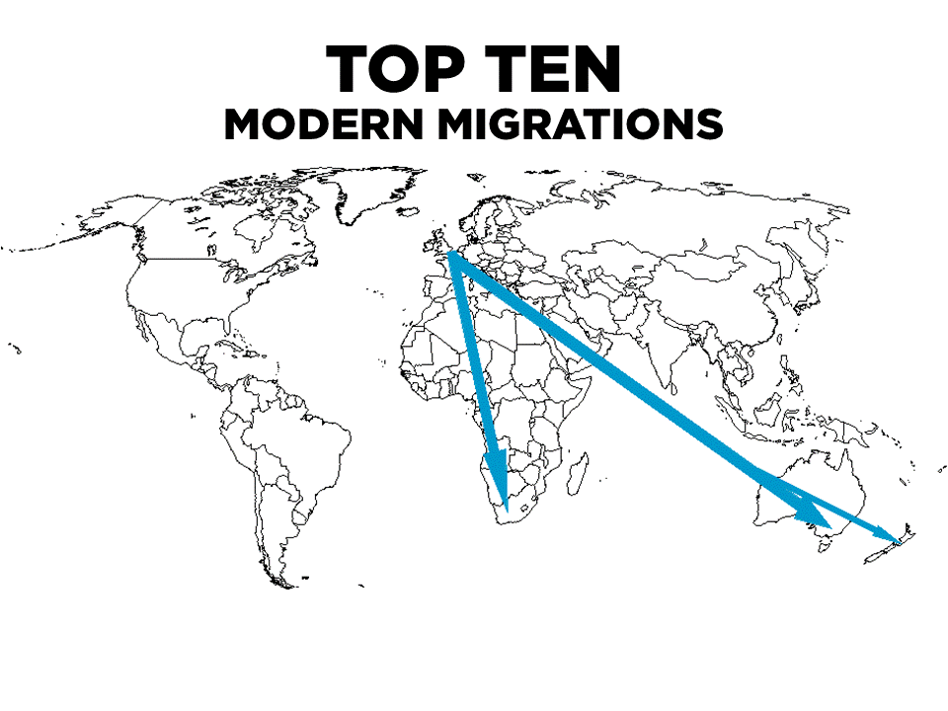
TOP ELEVEN

Slide 12
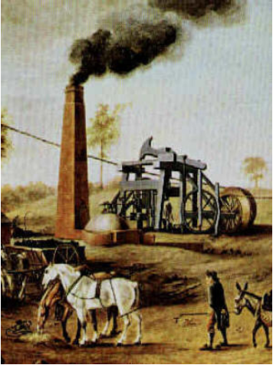
British Isles to South Africa and Australia
Australia, New Zealand, and South Africa all speak English
British Empire (Commonwealth)
Voluntary Movement
Industrial Revolution
Mercantilism

Slide 13
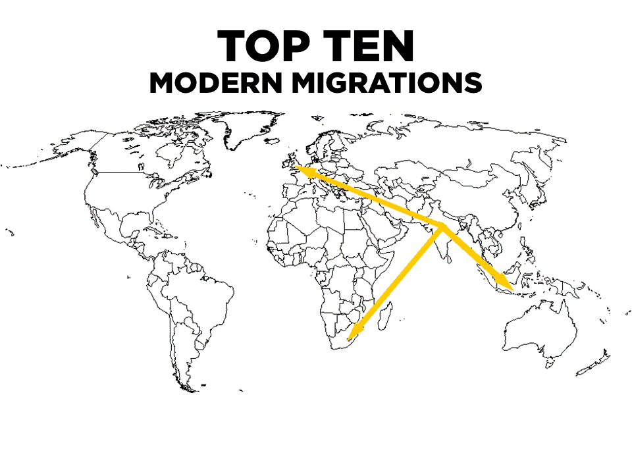
TOP ELEVEN

Slide 14
From India to South Africa, Fiji, Mauritius, Trinidad, Myanmar, Malaysia & British Guiana
Slavery abolished by Britain-indentured Indians went into the Empire to work
22 million-10 are Indian Citizens the rest are of Indian origin

Slide 15
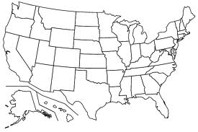

Slide 16
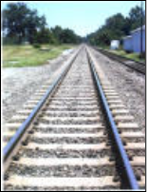
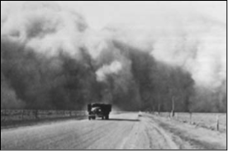
From Eastern North America to Western United States
Pioneers
Homestead Act
Gold Rush
Dust Bowl
Railroads
Manifest Destiny

Slide 17
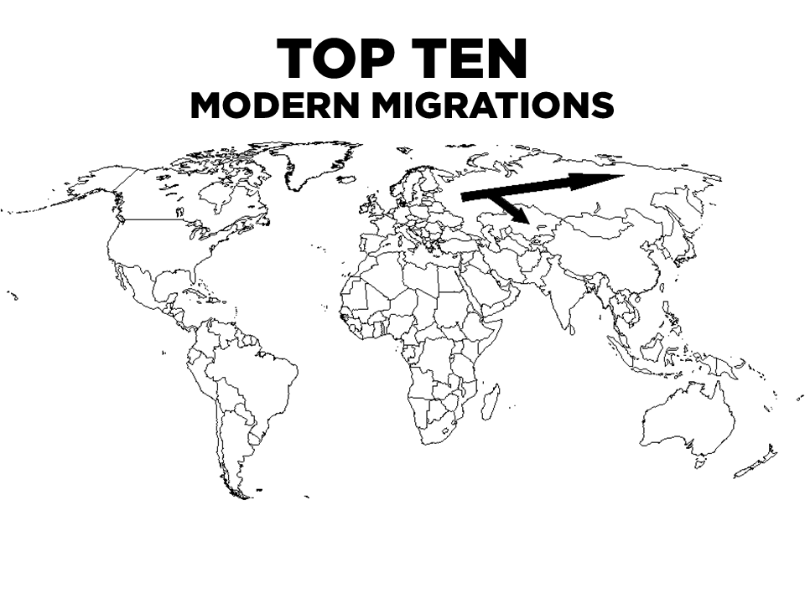
TOP ELEVEN

Slide 18
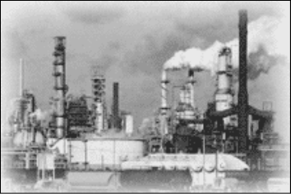
From Western Russia to Central Asia and Siberia
Begins with Peter the Great’s conquests and continues through the Soviet resettlement of Russians throughout the Soviet Union
Russia is the lingua franca of Central Asia and the Caucasus
Russians now migrating BACK to European Russia from these areas
Reservations for Native Siberians
Central Asia: factories
Siberia: rich in natural resources
- Fossil Fuels
- Minerals
- Forests

Slide 19
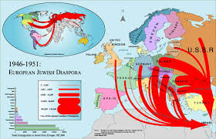
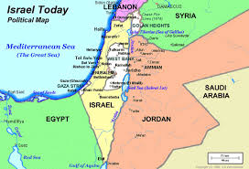
From Russia, Arab countries in Middle East, and Ethiopia to Israel
After Israel is created post WWII, Jews flow back to this area
Destabilizing force in a very volatile region

Slide 20
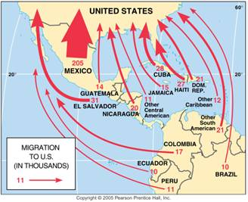
From Latin Americas to United States
Political & civil turmoil and wars (Guatemala)
Economic opportunity

Slide 21
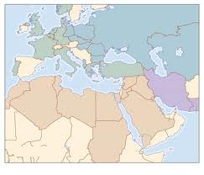
North Africans & Middle Easterners to Western Europe
From a region of growing population to a region of decreasing
Most as guestworkers

Slide 25
