Slide 1
THE BORCHERT MODEL
American Metropolitan Evolution

Slide 2
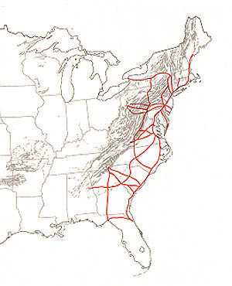
SAIL-WAGON EPOCH
Roads in 1775

Slide 3
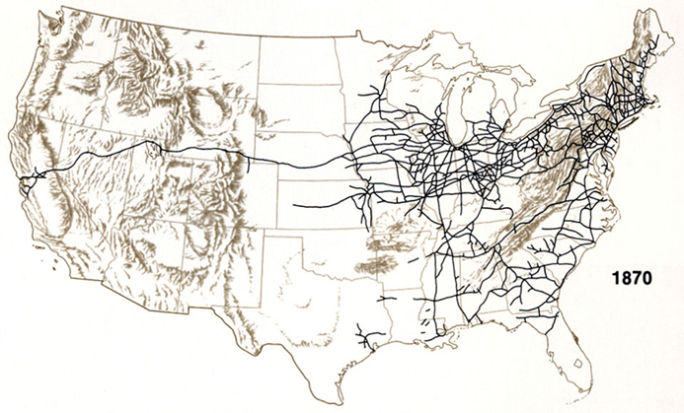
Iron Horse Epoch
Rail Network, 1870

Slide 5
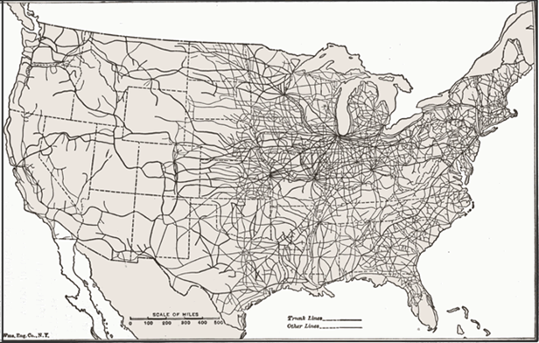
STEEL RAIL EPOCH
US Rail Network, 1920

Slide 6
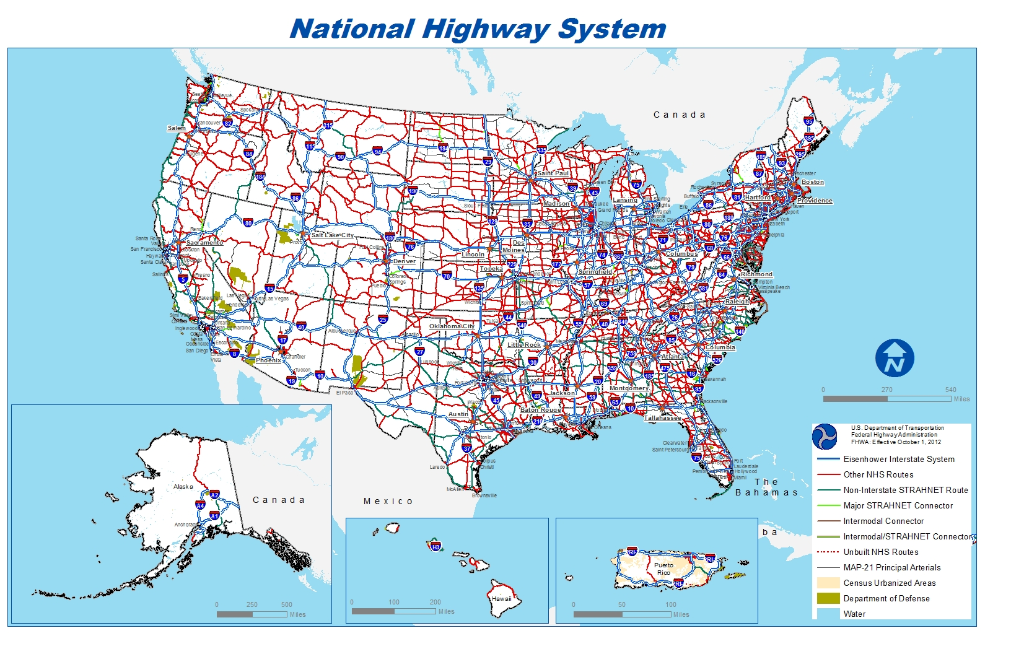
AUTO-AIR-AMENITY EPOCH

Slide 7
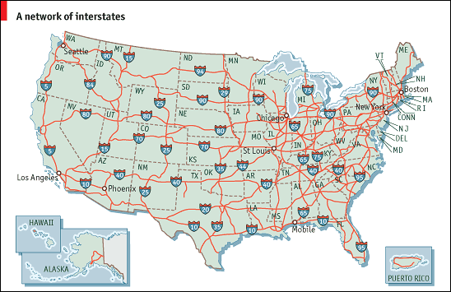
AUTO-AIR-AMENITY EPOCH

Slide 8
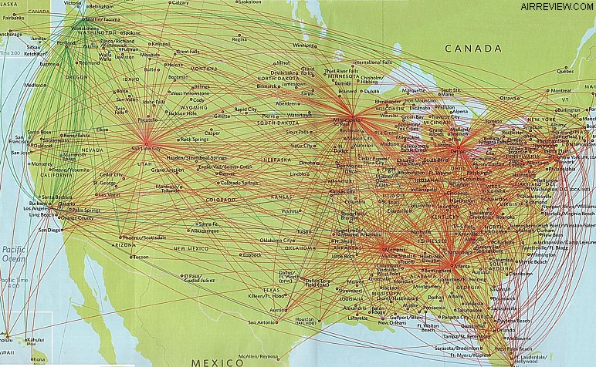
SATELLITE-ELECTRIC-JET PROPULSION EPOCH
DELTA AIRLINES

Slide 9
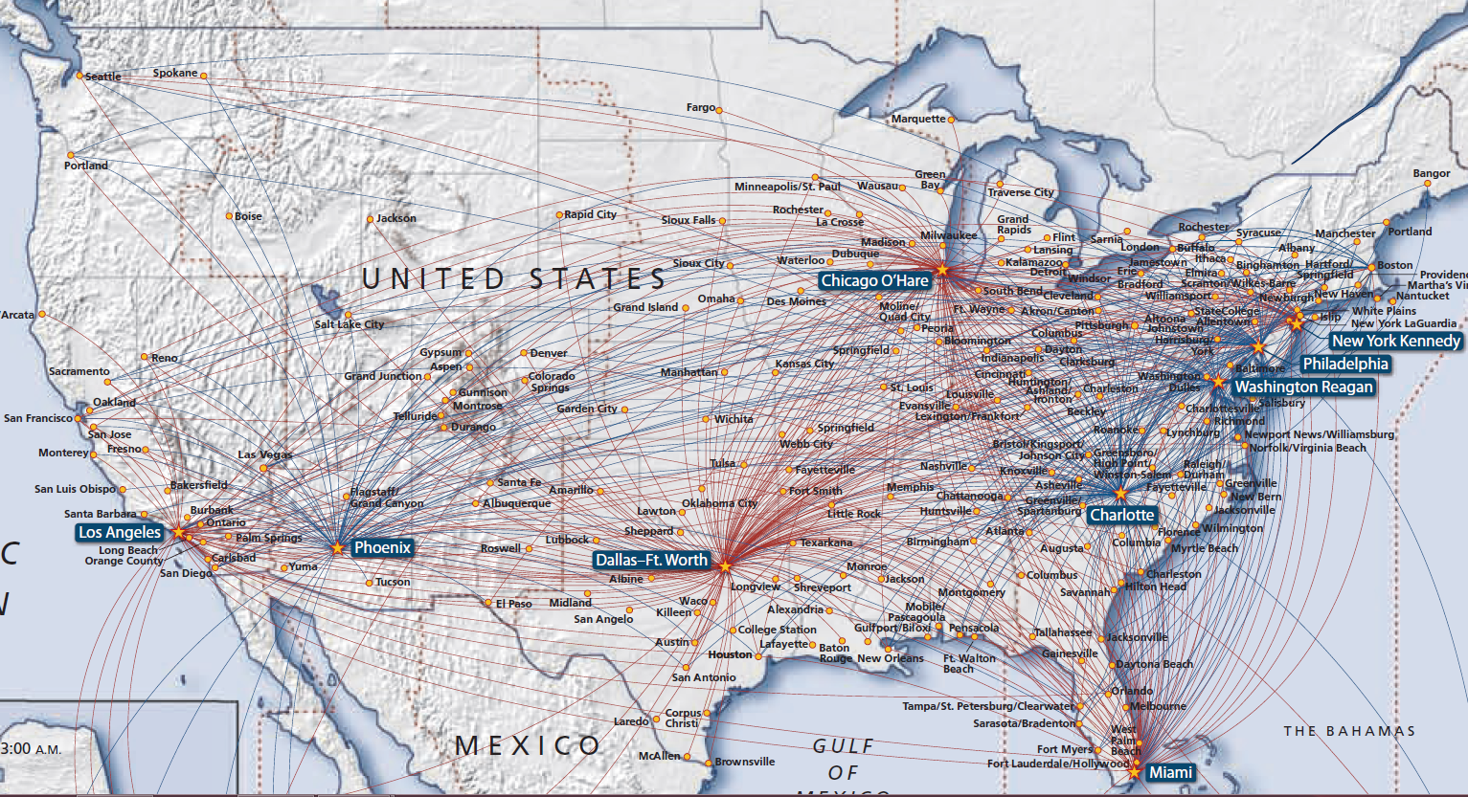
US AIRWAYS

Slide 10
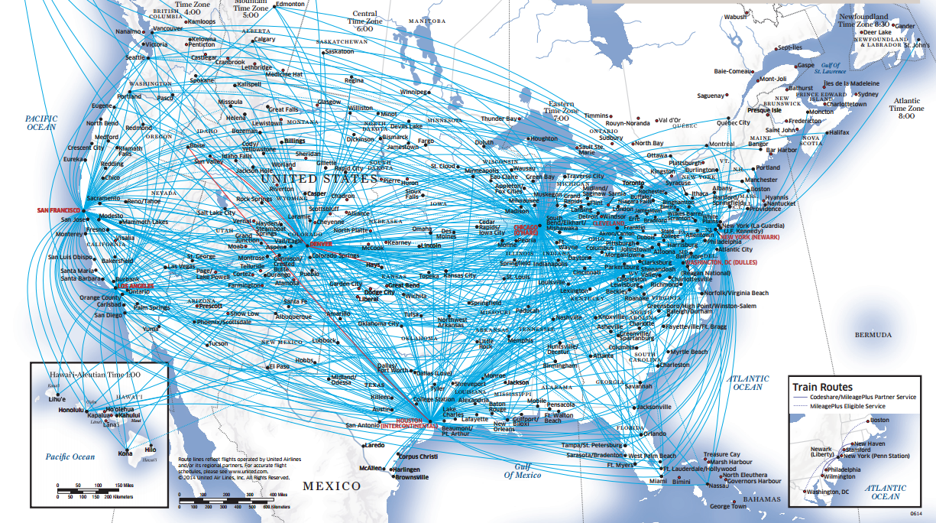
UNITED AIRLINES

Slide 11
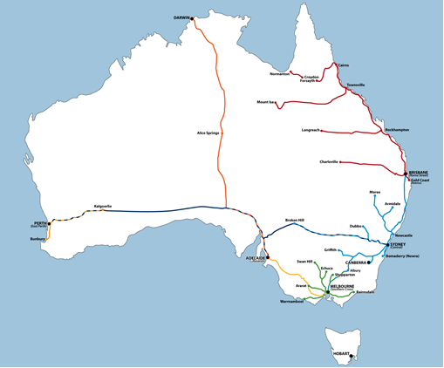

Slide 12
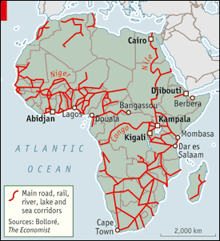
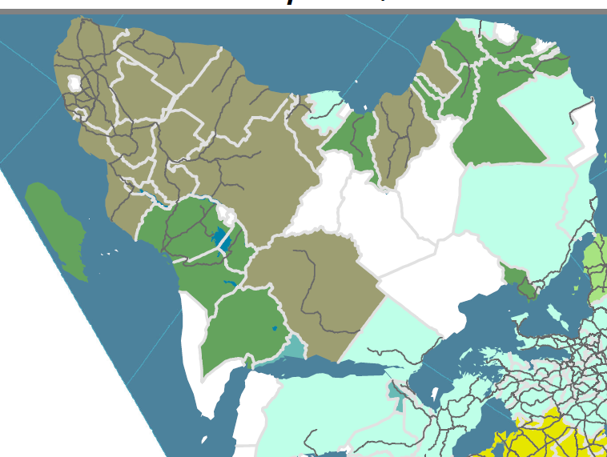

Slide 13
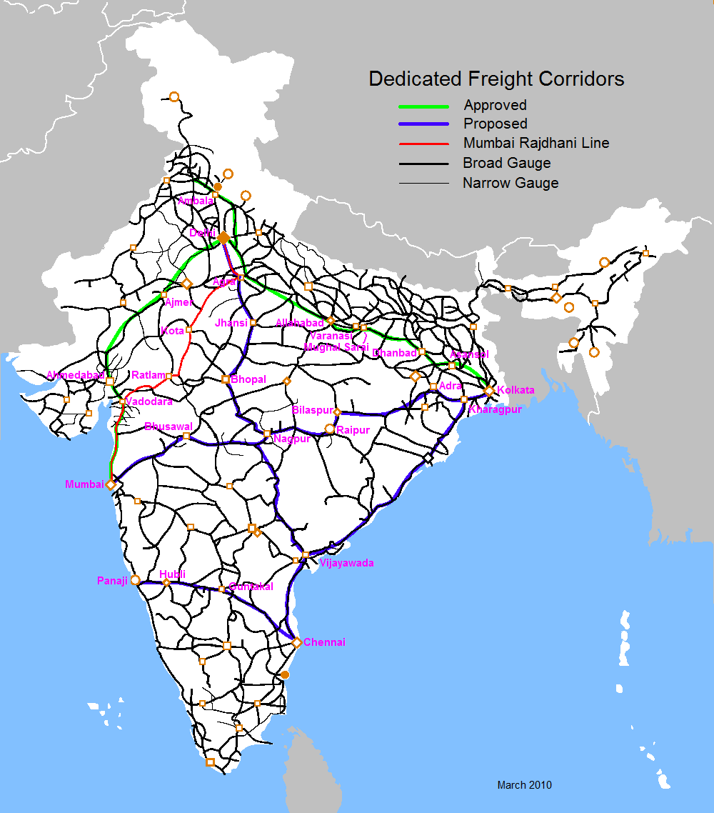
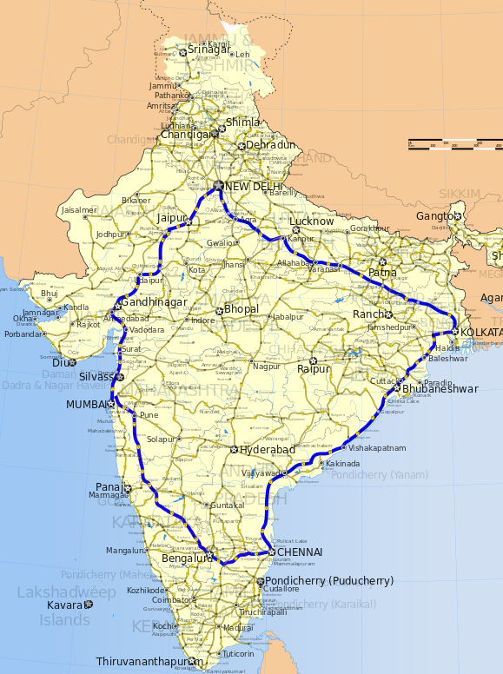

Slide 14
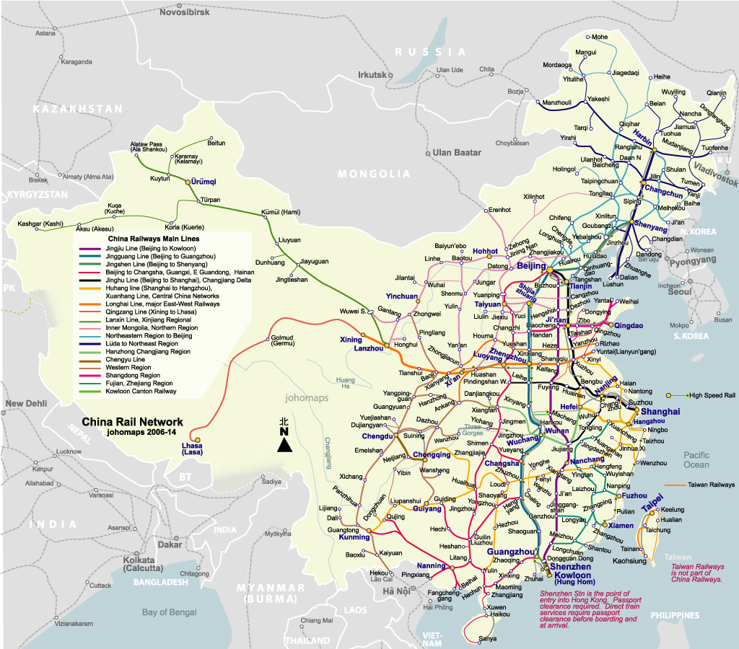

Slide 15
