Slide 1
European Boundaries through maps
Sharon Shelerud

Slide 2
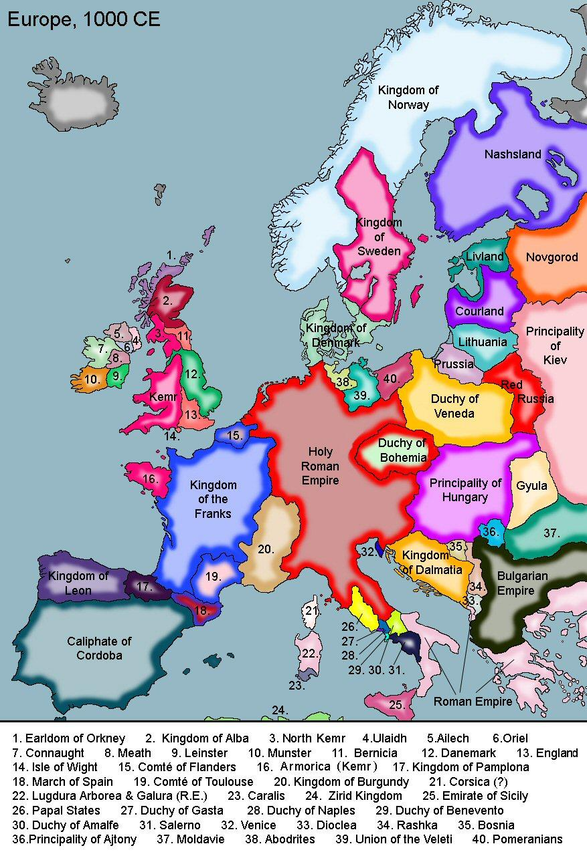

Slide 3
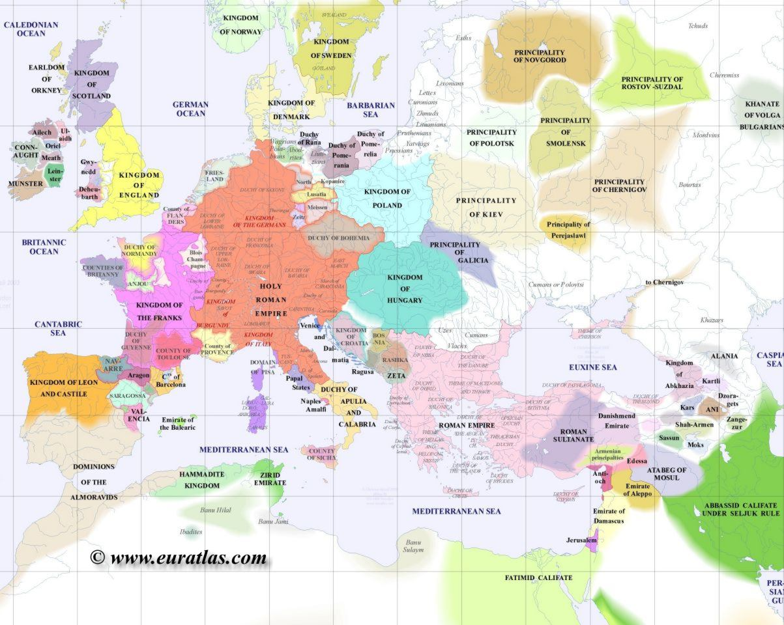
Europe 1110

Slide 4
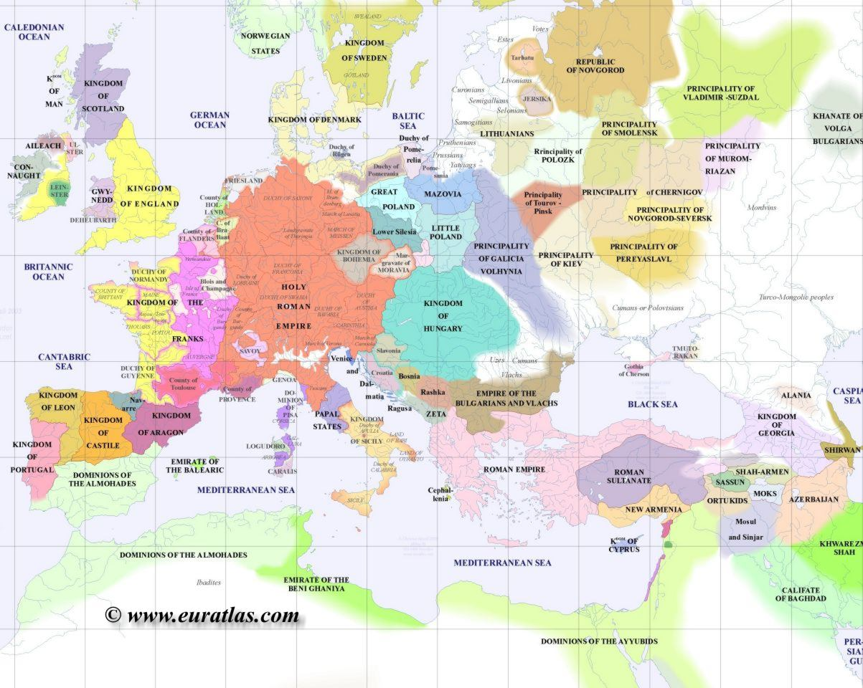
Europe 1200

Slide 5
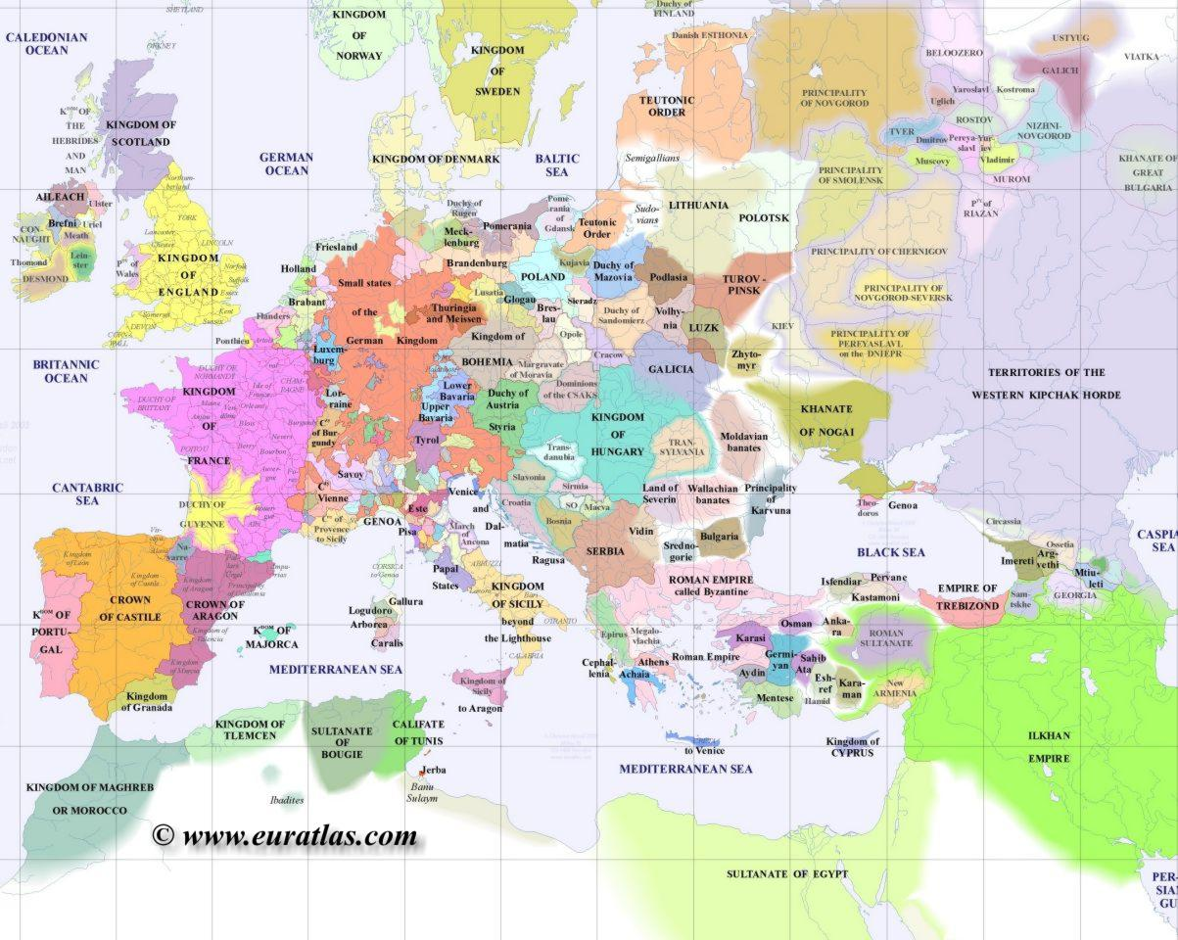
Europe 1300

Slide 6
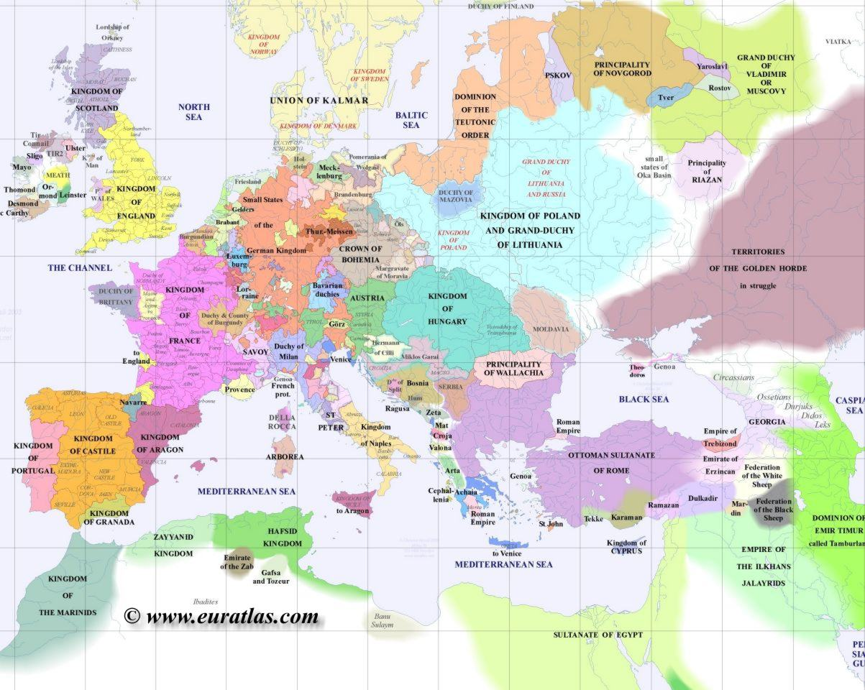
Europe 1400

Slide 7
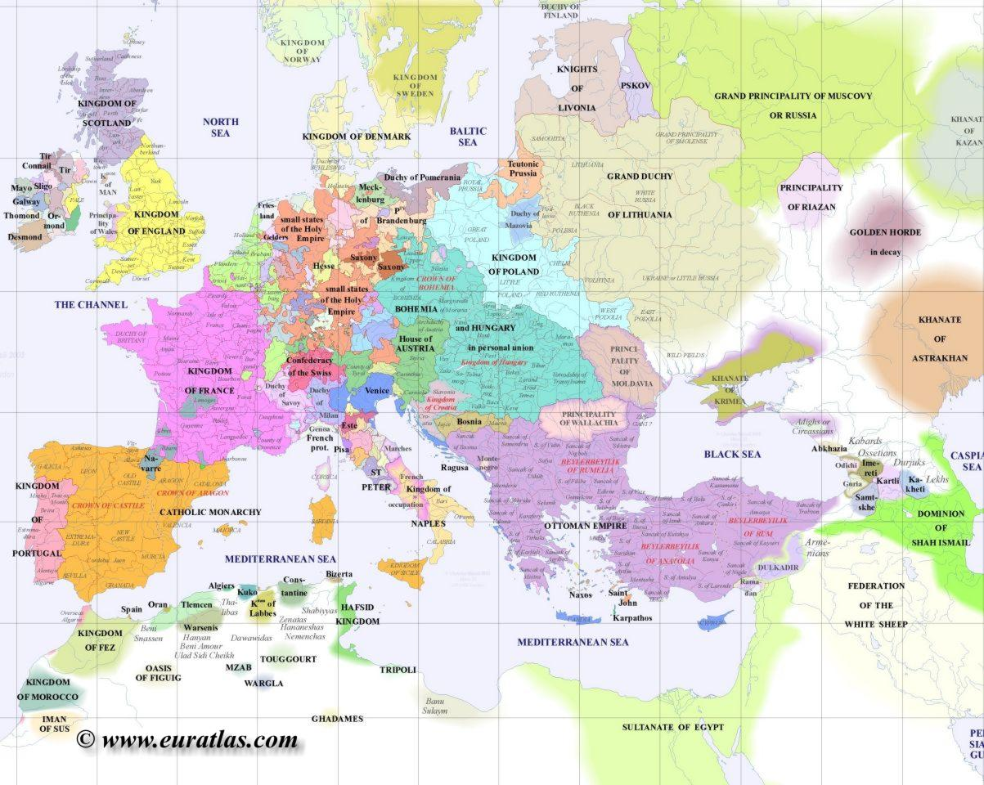
Europe 1500

Slide 8
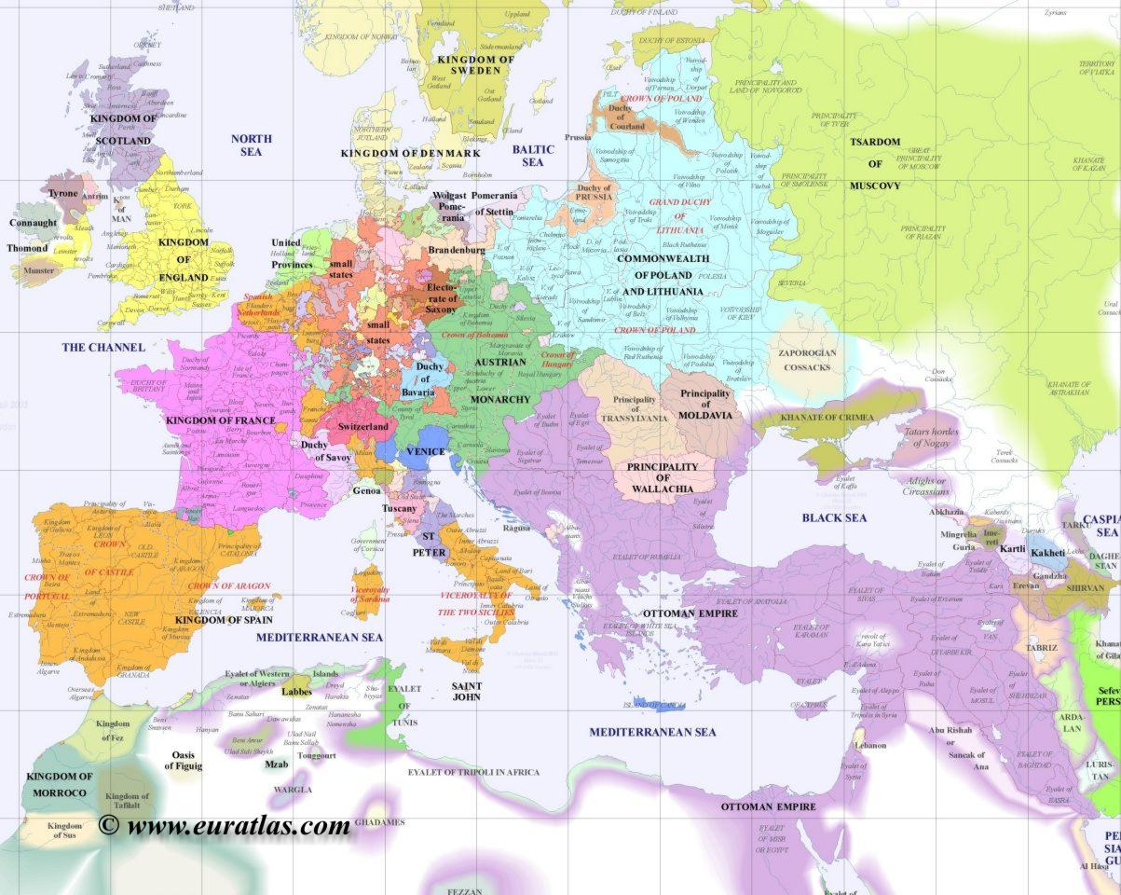
Europe 1600

Slide 9
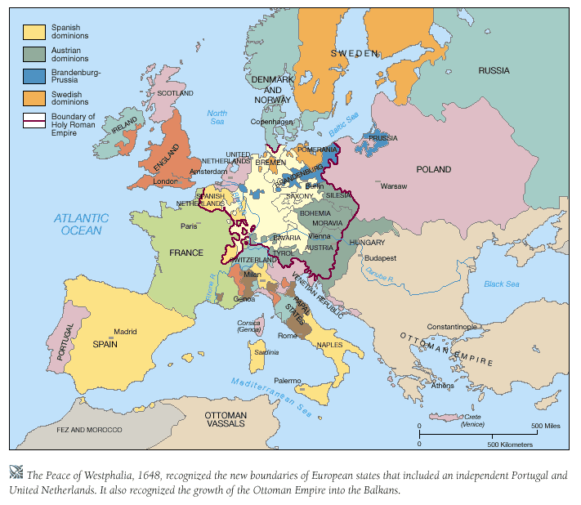

Slide 10
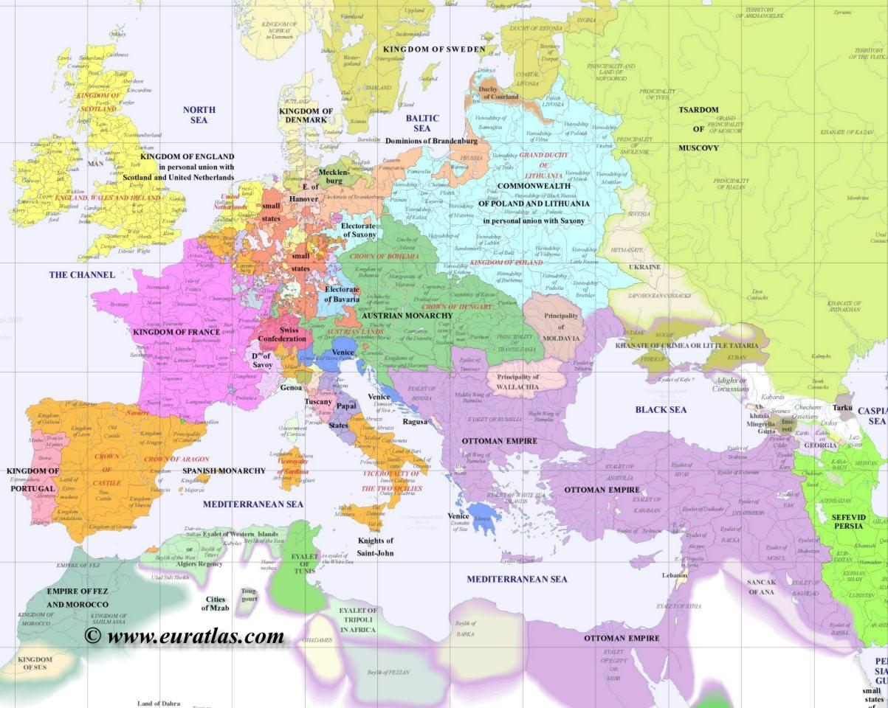
Europe 1700

Slide 11
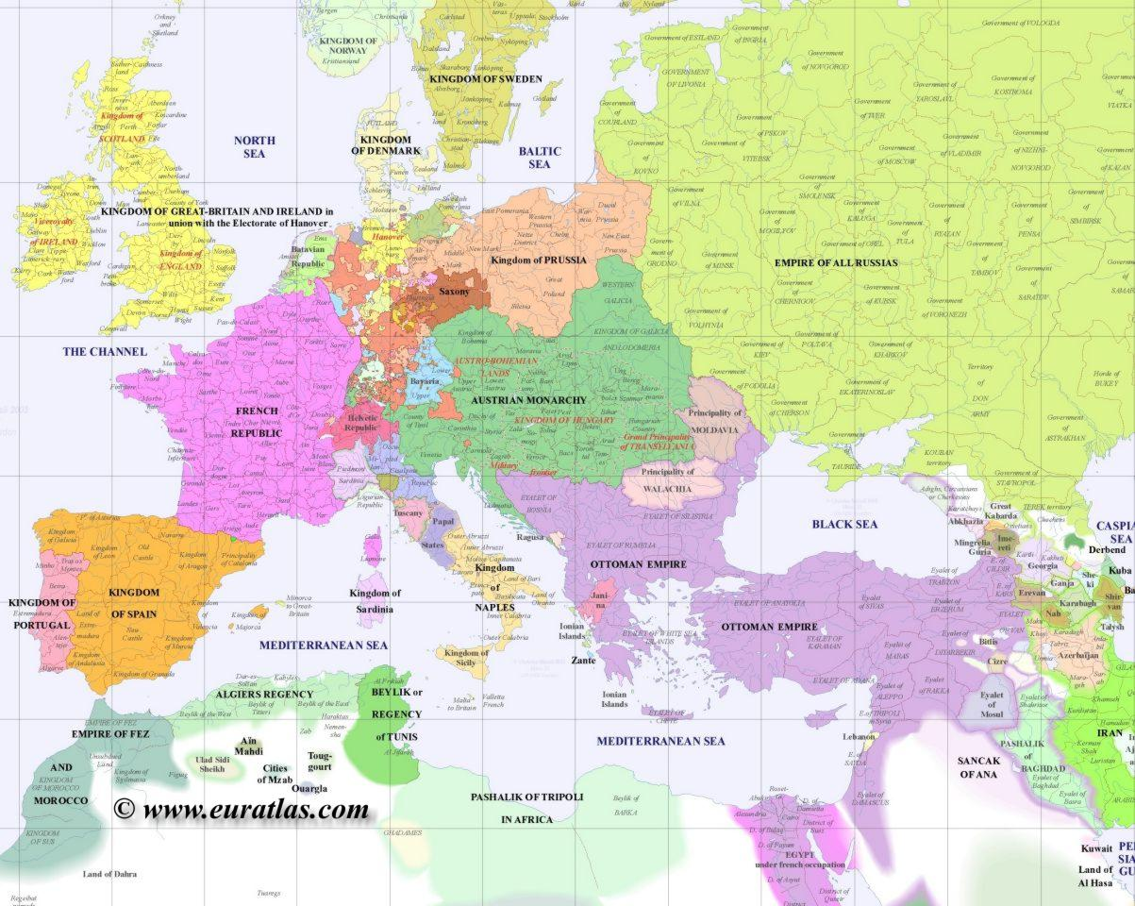
Europe 1800

Slide 12
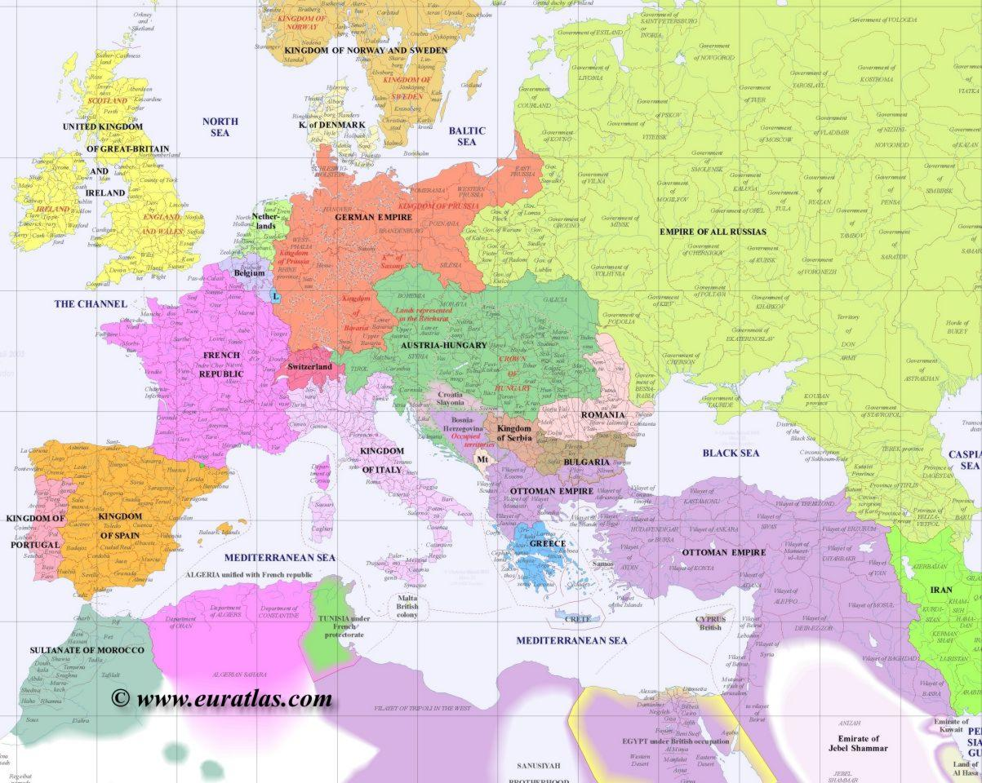
Europe 1900

Slide 13
Europe 1917

Slide 15
Europe 1939

Slide 18
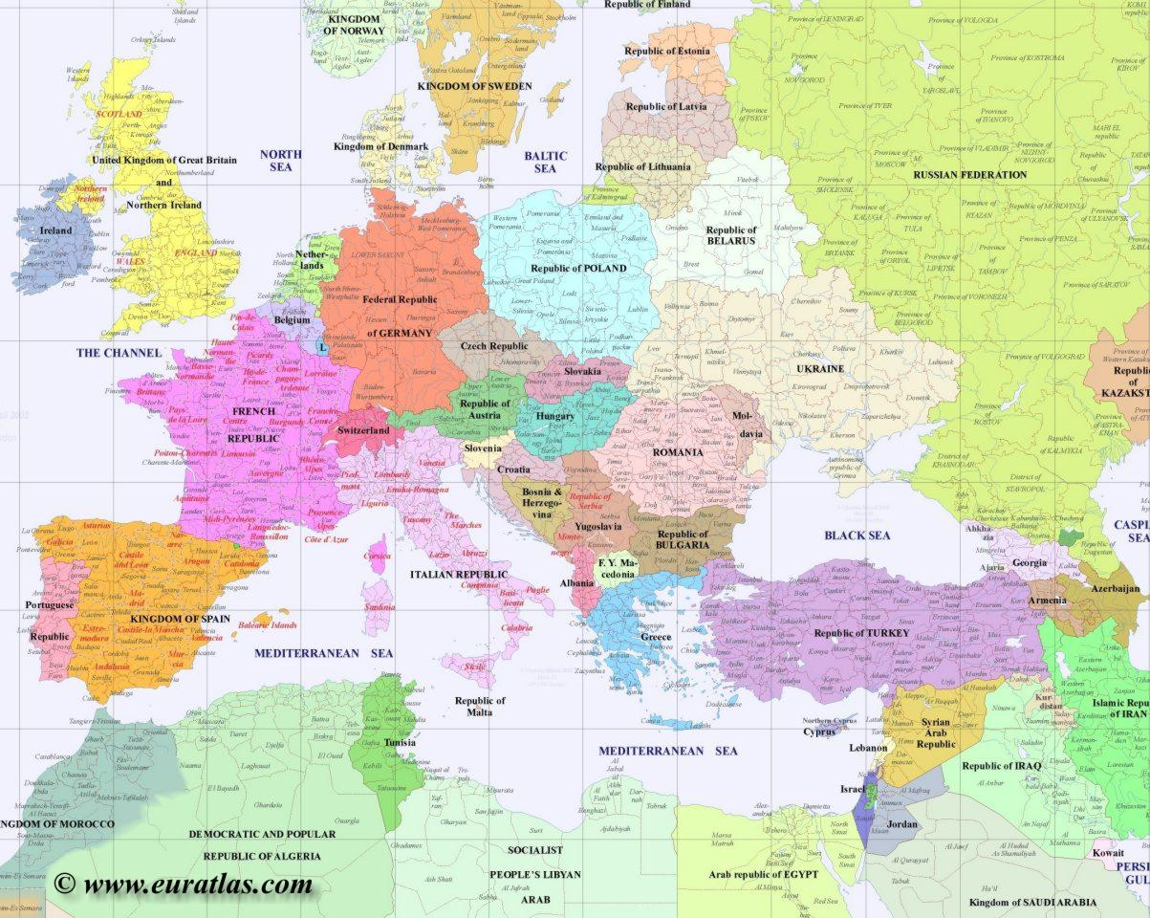
Europe 2000

Slide 20
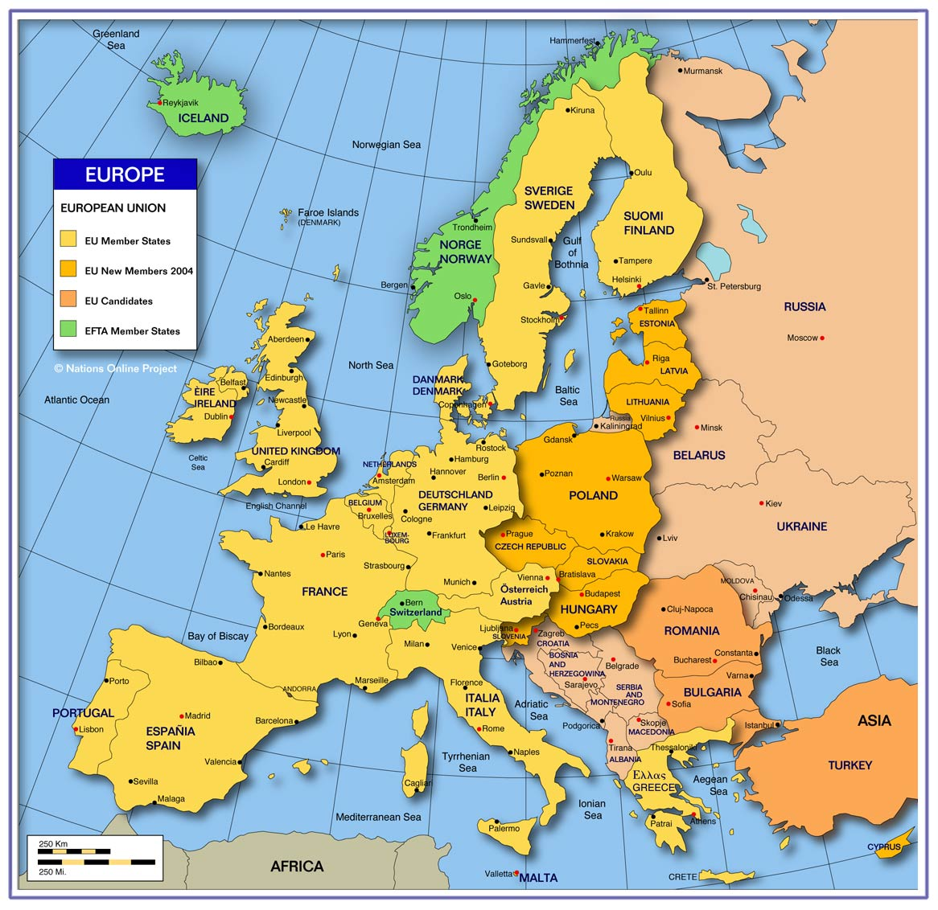

Slide 21
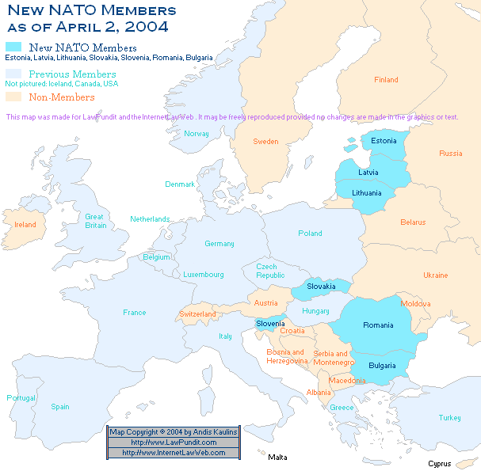

Slide 22
