Slide 1
Hungry Planet
Peter Menzel traveled the world documenting that most basic of human behaviors — what we eat. Their project, “Hungry Planet,” depicts everything that an average family consumes in a given week–and what it costs — laid out in thought-provoking detail. Their results will be exhibited by The Nobel Peace Center to give viewers a peek into kitchens from Norway to Kuwait, and to raise awareness about how environments and cultures influence the cost and calories of the world’s dinners.

Slide 2
Australia…
…$428

Slide 3
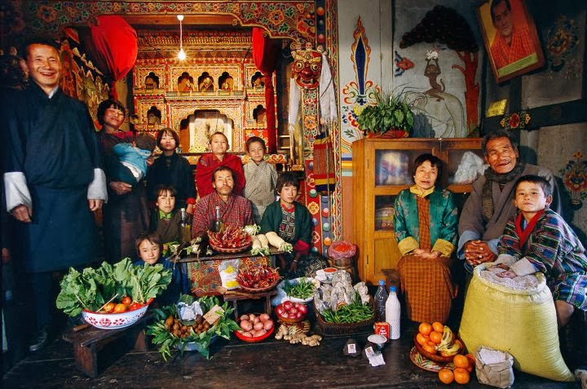
Bhutan…
…$5

Slide 4
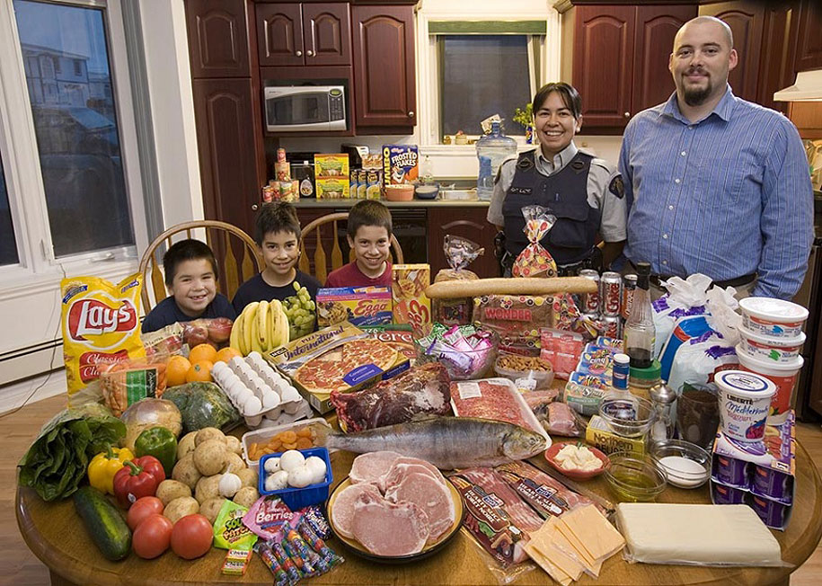
Canada…
…$392

Slide 5
Chad…
…$1.25

Slide 6
China…
…$65

Slide 7
China (2)…
…$142

Slide 8
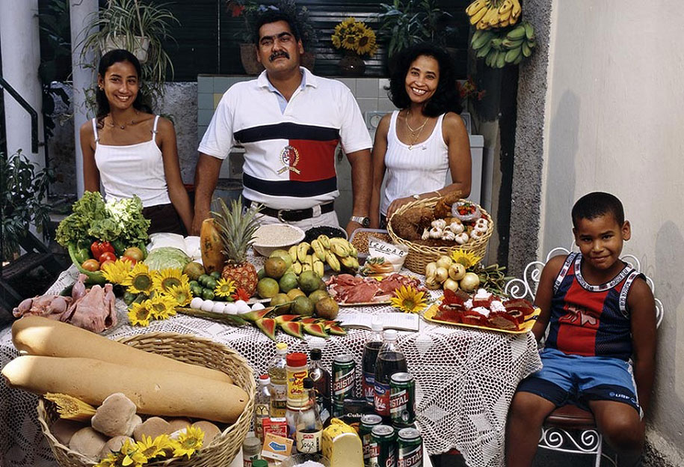
Cuba…
…$65

Slide 9
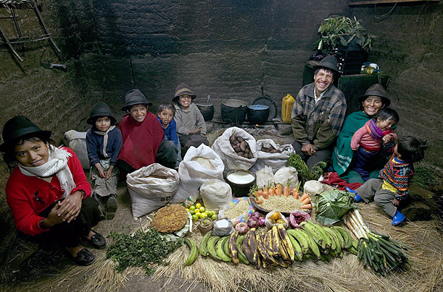
Ecuador…
…$32

Slide 10
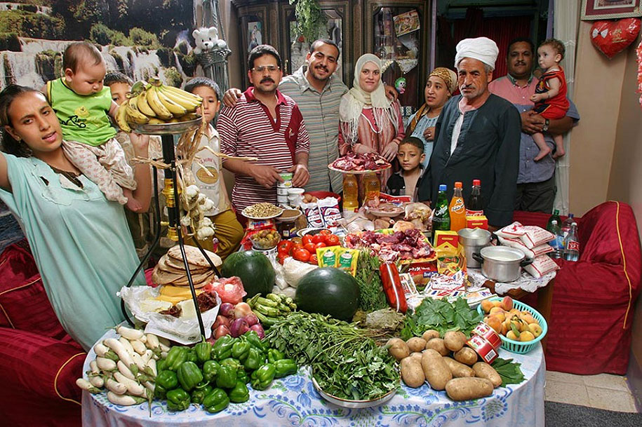
Egypt…
…$78

Slide 11
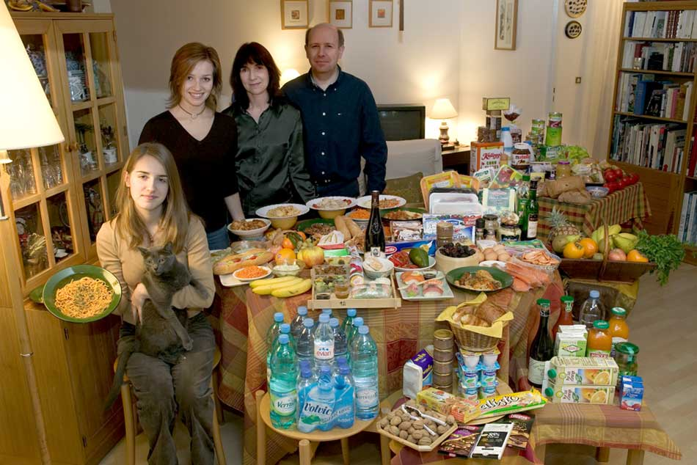
France…
…$421

Slide 12
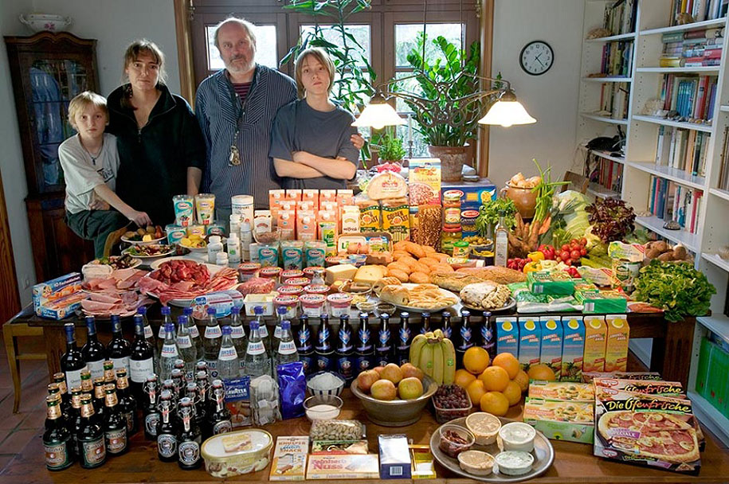
Germany…
…$568

Slide 13
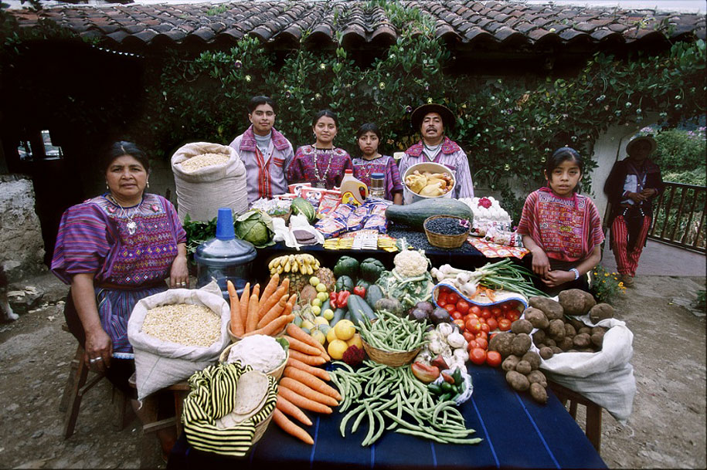
Guatemala…
…$76

Slide 14
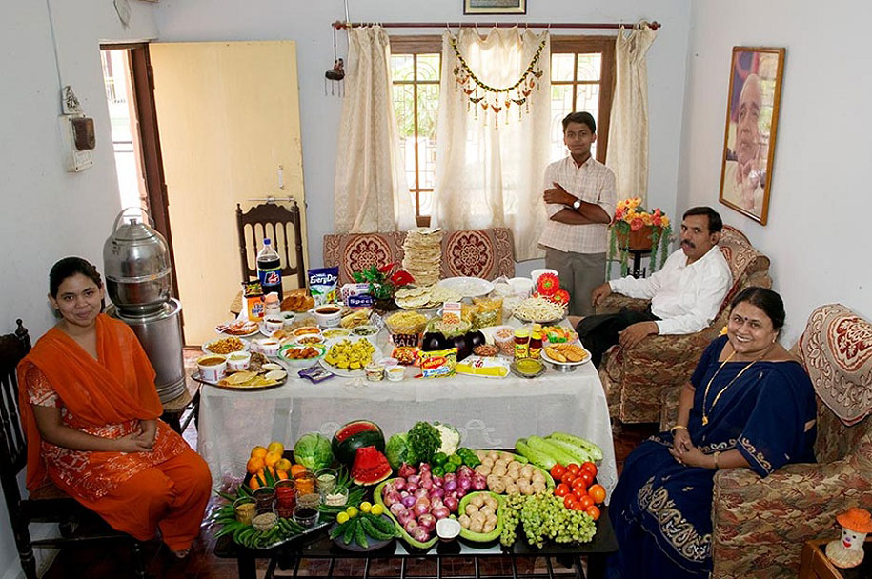
India…
…$45

Slide 15
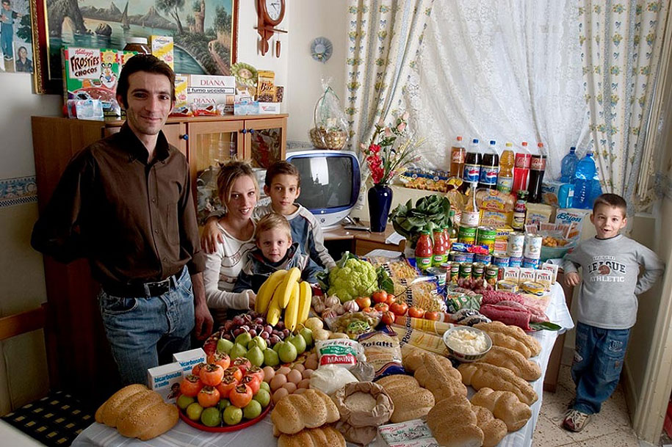
Italy…
…$295

Slide 16
Japan…
…$362

Slide 17
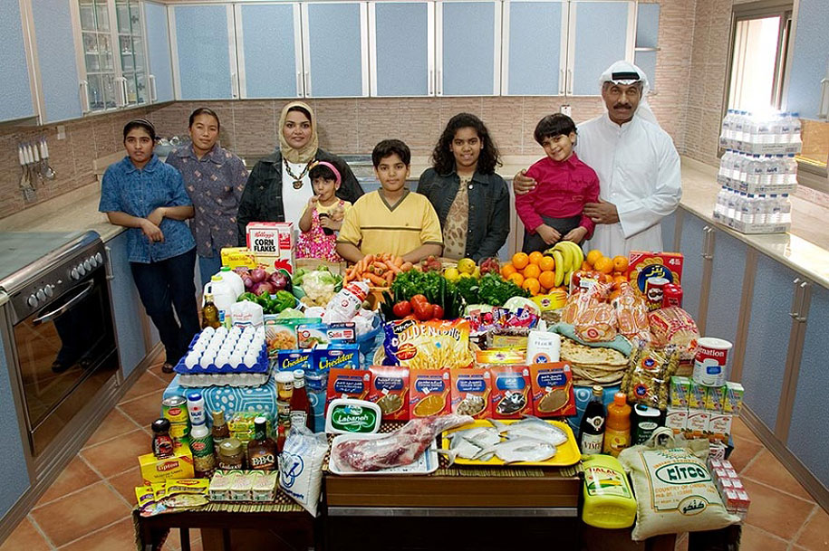
Kuwait…
…$252

Slide 18
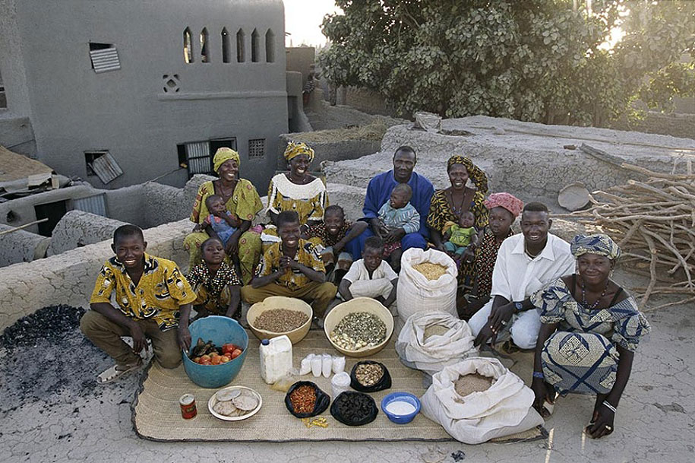
Mali…
…$26

Slide 19
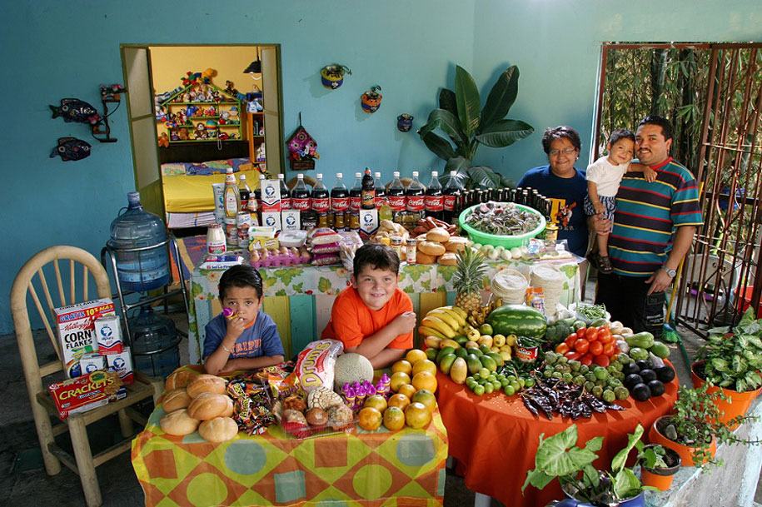
Mexico…
…$189

Slide 20
Mongolia…
…$42

Slide 21
Norway…
…$379

Slide 22
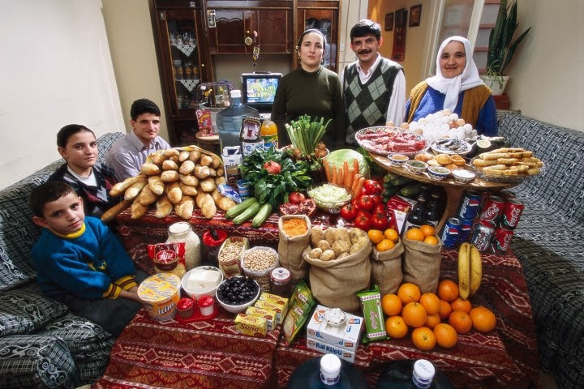
Turkey…
…$132

Slide 23
United States…
…$342

