Slide 1
Chapter 9
Intro to Development

Slide 2
Rich and Poor
The world is divided between relatively rich and relatively poor countries.
Geographers try to understand the reasons for this division and learn what can be done about it.

Slide 3
Development
The Key Issues are:
Why does development vary among countries?
Where are more and less developed countries distributed?
Where does level of development vary by gender?
Why do less developed countries face obstacles to development?

Slide 4
MDC’s vs. LDC’s
Earth’s nearly 200 countries can be classified according to their level of development, which is the process of improving the material conditions of people through diffusion of knowledge and technology.
The development process is continuous.
For more developed regions, the economic challenge is to maintain a high level of development at the new scale.
For less developed countries, the challenge is to find connections to the global economy that take advantage of local skills and resources.

Slide 5
Key Issue 1: Indicators of Development
Economic indicators of development
Gross domestic product per capita
Types of jobs
Raw materials
Consumer goods
Social indicators of development
Education and literacy
Health and welfare
Demographic indicators of development
Life expectancy
Natural increase rate
Infant mortality rate
Crude birth rate

Slide 6
Level of Development
MDC: More Developed Country, also known as a Relatively Developed country or Developed Country. A country which has progressed economically along certain measurable milestones (literacy rates, GNP, income – we will discuss)
LDC: Less Developed Country, also known as Developing, or Emerging.
We often use the terms, First World, Third World – but in this class and for your future, Developed and Emerging or Developing will do.

Slide 7
Demographic, Social, and Economic Indicators of Development
LDC
MDC
Crude Birth Rate = high
Crude Death Rate = low
Infant Mortality Rate = high
Literacy Rate = low
School Enrollment = low
Total Fertility Rate =high
Total % of pop under 15 =high
Life Expectancy = low
Natural Increase Rate = high
GDP per Capita = low
Primary Economic Activities= high
Service Economic Activities =low
Crude Birth Rate = low
Crude Death Rate =low
Infant Mortality Rate = low
Literacy Rate = high
School Enrollment = high
Total Fertility Rate = low
Total % of pop under 15 = low
Life Expectancy = high
Natural Increase Rate = low
GDP per Capita = high
Primary Economic Activities =low
Service Economic Activities = high

Slide 8
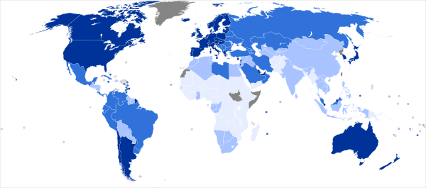
Human Development Index
The Human Development Index (HDI) is a composite statistic of
A decent standard of living (economic)
A long and healthy life (demographic)
Access to knowledge (social)
Computed by the UN for countries since 1980
HDI ranks countries into four tiers of human development
Very high Developed (above 0.79)
High developing (0.70-0.79)
Medium developing (0.52-0.69)
Low developing (below 0.52)

Slide 9
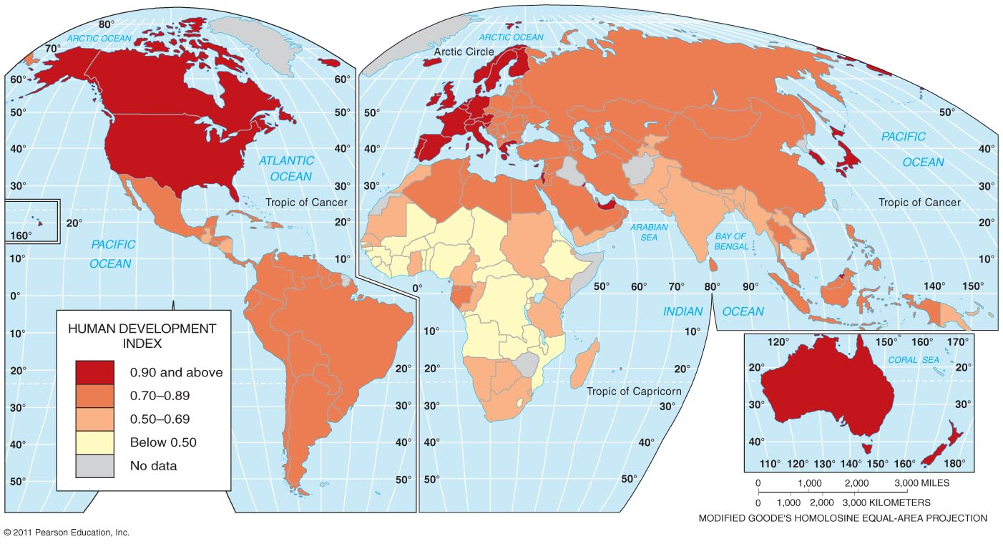
Human Development Index
Fig. 9-1: Developed by the United Nations, the HDI combines several measures of development: life expectancy at birth, adjusted GDP per capita, and knowledge (schooling and literacy).

Slide 10
Human Development Index HDI An interactive map showing all indices http://hdr.undp.org/en/data/map/

Slide 11
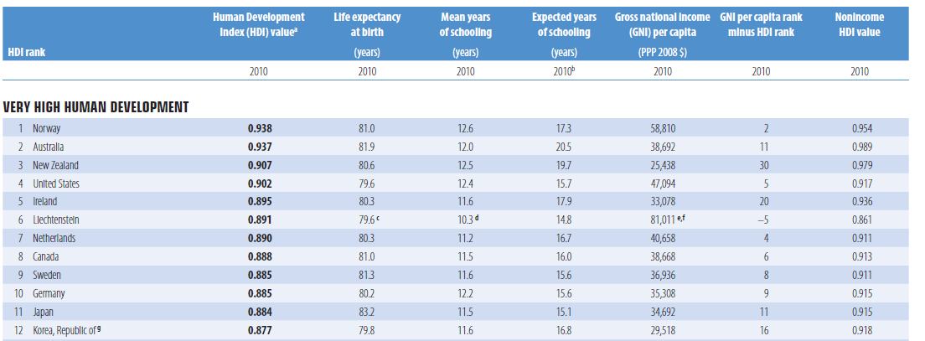

Slide 12
Economic Indicators of Development
The United Nation’s HDI includes one economic indicator of development: gross domestic product per capita.
Four other economic indicators distinguish more developed from less developed countries:
economic structure
worker productivity
access to raw materials
and availability of consumer goods.

Slide 13
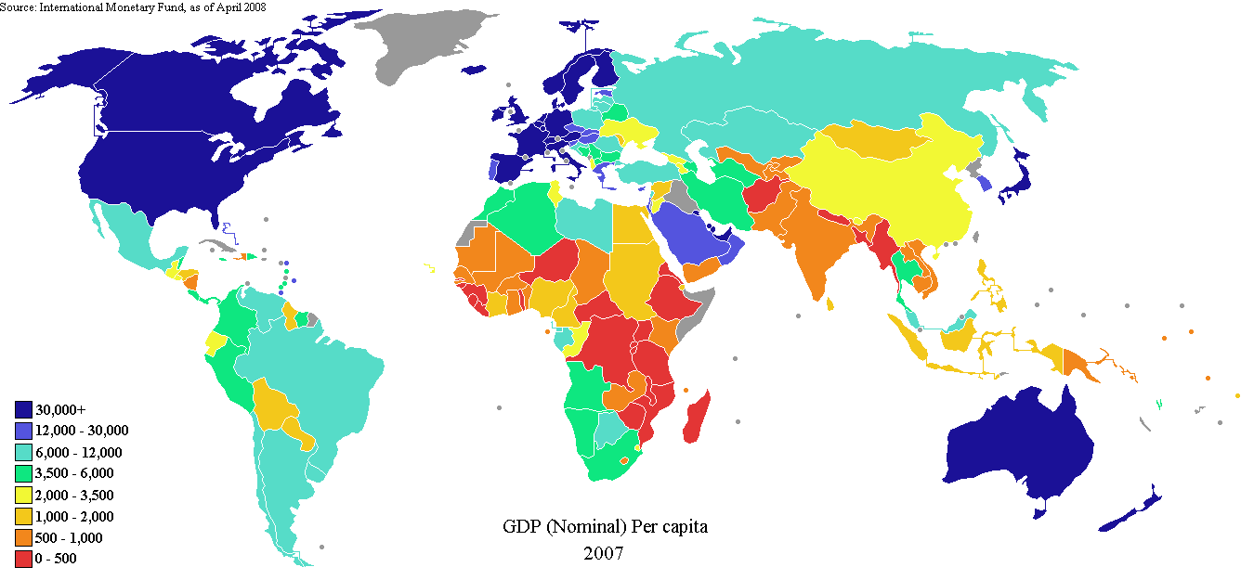
Economic Factors
GDP: Gross Domestic Product. How much on average does each person earn per year?

Slide 14
Gross Domestic Product Per Capita
The typical worker receives $10 to $15 per hour in more developed countries, compared to less than $0.50 per hour in less developed ones.
Per capita income is a difficult figure to obtain
Geographers substitute per capita gross domestic product, a more readily available indicator, dividing the GDP by total population.
The gross domestic product (GDP) is the value of the total output of goods and services produced in a country, normally during a year.

Slide 15
Annual GDP per Capita
Fig. 9-2: Annual gross domestic product (GDP) per capita averages over $20,000 in most developed countries but under $5,000 in most less developed countries.

Slide 16
Measuring Development
Gross National Product (GNP) Measure of the total value of the officially recorded goods and services produced by the citizens and corporations of a country in a given year. Includes things produced inside and outside a country’s territory.
Gross Domestic Product (GDP) Measure of the total value of the officially recorded goods and services produced by the citizens and corporations of a country in a given year.
Gross National Income (GNI) Measure of the monetary worth of what is produced within a country plus income received from investments outside the country. ** Most common measurement used today.
GNP or GDP does not reflect regional variations-it also doesn’t count the informal economy-black market, illegal drug trade & underground economy

Slide 17
Gross National Income (GNI)
GNI (gross national income)
Another economic indicator-the value of the output of goods and services produced in a country in a year, including money that leaves and enters the country.

Slide 18
So what’s the difference?!?
1. Gross Domestic Product is the value produced within a country’s borders, whereas the Gross national Income is the value produced by all the citizens.
2. GDP is said to be the measure of a country’s overall economic output. The GNI is the total value that is produced within a country, which comprises of the Gross Domestic Product along with the income obtained from other countries (dividends, interests).
3. Gross Domestic Product helps to show the strength of a country’s local income. On the other hand, Gross National Income helps to show the economic strength of the citizens of a country.
4. GNI is based on ownership, and GDP is based on location.

Slide 19
Issues with Measuring Economic Development
All measurements count the:
Formal Economy – the legal economy that governments tax and monitor.
All measurements do not count the:
Informal Economy – the illegal or uncounted economy that governments do not tax or keep track of.
Notes:
Many countries have per capita GNI of less than $1,000 per year –key to survival in these countries is the informal economy the illegal or uncounted economy.
Garden plots in backyard, to black market and even illegal drug sales

Slide 20
HDI only includes income from the formal market. Reported to and monitored by the government, pay taxes.
Formal Market: Ecuador
Informal Market: Ecuador

Slide 21
HDI does not include income from the informal market. Not reported to or regulated by the government, no taxes paid.
Formal Market: Brazil
Informal Market: Recife, Brazil

Slide 22
Productivity
Productivity is the value of a particular product compared to the amount of labor needed to make it.
Workers in more developed countries produce more with less effort because they have access to more machines, tools, and equipment to perform much of the work.
Productivity can be measured by the value added per worker, the gross value of the product minus the costs of raw materials and energy.

Slide 23
Raw Materials
Development requires access to raw materials, such as minerals and trees, which can be fashioned into useful products.
It also requires energy to operate the factories.
The United Kingdom, the first country to develop in the eighteenth century, had abundant supplies of coal and iron ore, used to make steel for tools.
European countries took advantage of domestic coal and iron ore to promote industrial development during the nineteenth century.
As they ran short of many raw materials, European countries began to import them.
The international flow of raw materials sustained development in Europe but retarded it in Africa and Asia.
Most former colonies still export raw materials and import finished goods and services.
The LDCs that possess energy resources, especially petroleum, have been able to use revenues to finance development.
Prices for other raw materials, such as cotton and copper, have fallen because of excessive global supply and declining industrial demand.
A country with abundant resources has a better chance of developing.
Yet some countries that lack resources—such as Japan, Singapore, South Korea, and Switzerland—have developed through world trade.

Slide 24
Consumer Goods
Part of the wealth generated in more developed countries goes for essential goods and services (food, clothing, and shelter).
But the rest is available for consumer goods and services.
The wealth used to buy “nonessentials” promotes expansion.
Among the thousands of things that consumers buy, three are particularly good indicators of a society’s development:
motor vehicles,
telephones,
and televisions.

Slide 25
Telephones per Population
Fig. 9-4: Mean telephone lines per 1,000 persons, 2002. MDCs have several dozen phone lines per 1,000 persons, while the poorer developing countries may have less than 10.

Slide 26
“Haves” and “Have-nots”
The motor vehicle, telephone, and television all play important economic roles.
In contrast, in less developed countries, these products do not play a central role in daily life.
The number of individuals per telephone and motor vehicle exceeds 100 in most LDCs.
The number of persons per television set varies widely.
The variation reflects the rapid diffusion of television in recent years in LDCs.
Most people in LDCs are familiar with these consumer goods, even though they cannot afford them.
The minority who have these goods may include government officials, landowners, and other elites, whereas the majority who are denied access to these goods may provoke political unrest.
In many LDCs the “haves” are concentrated in urban areas; the “have-nots” live in the countryside.

Slide 27
Types of Jobs
Average per capita income is higher in MDCs because people typically earn their living by different means than in LDCs.
Jobs fall into three categories:
primary (including agriculture),
secondary (including manufacturing),
and tertiary (including services).
Workers in the primary sector directly extract materials from Earth.
The secondary sector includes manufacturers.
The tertiary sector involves the provision of goods and services, retailing, banking, law, education, and government.

Slide 28
Types of jobs in an economy:
Primary (Earth)
Secondary (Value added)
Tertiary (Services – education)
Quartenary (Technology – actually part of Tertiary, but I feel it is warranted a separate category…)

Slide 29
Primary
Primary jobs include the extractive sector of the economy. People who are directly in contact and engaged with the earth:
Fishing, mining, farming, logging.

Slide 30
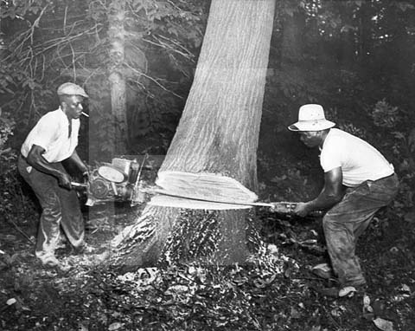
Secondary
Secondary jobs are in manufacturing. Value is added to something when it changes form into something more desirable and valuable.
Transforms raw materials into usable products, adding value in the process

Slide 31
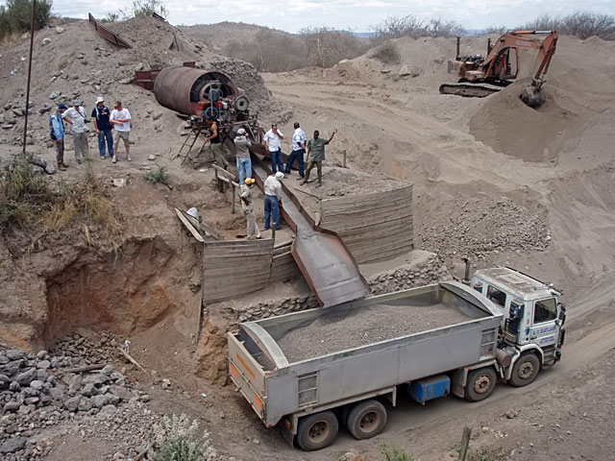
Secondary – Value added
Tanzanian iron ($200 per 4,000 #) ore into Japanese cars ($24,000 per 4,000#): whose profit would you like to earn?

Slide 32
Tertiary jobs
Tertiary jobs are service jobs. A person with specialized skills provides a service to another person for a fee. Doctor, lawyer, teacher, banker, accountant, architect, restaurant, store, government job.
Activity that links primary & secondary sectors to consumers and other businesses by selling goods or performing services; includes both retail and business (producer) services

Slide 33
Tertiary jobs

Slide 34
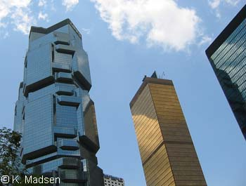
Quaternary jobs
Highly skilled, information-based services; usually includes management
Jobs that are involved with technology

Slide 35
Employment Changes by Sector
Fig. 9-3: Percentage employment in the primary, secondary, and tertiary sectors of MDCs has changed dramatically, but change has been slower in LDCs.

Slide 36
Structural Change in Economies
Division of Labor Varies by Level of Economic Development
Primary
Tertiary
Percentage of Work Force
Secondary
Quaternary
Pre-Industrial Industrial Post-Industrial
(LDCs) (NICs) (MDCs)

Slide 37
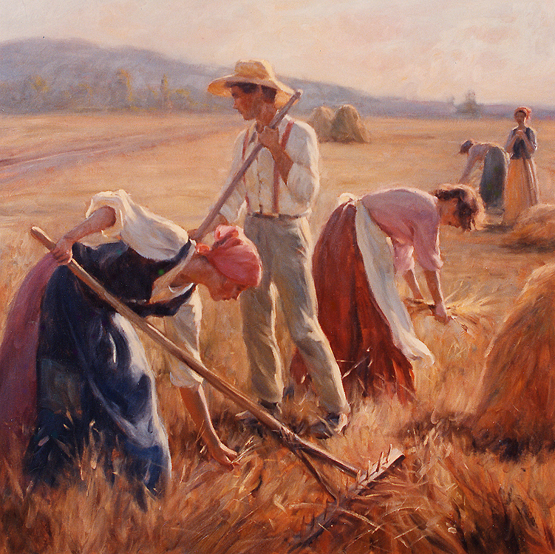
Which Sector???
TERTIARY
PRIMARY

Slide 38
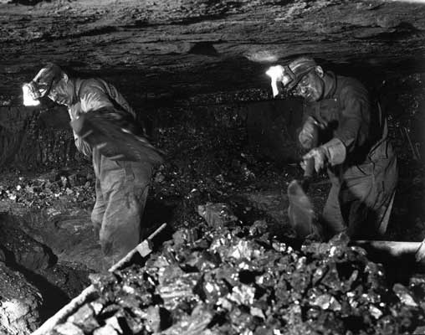
Which Sector???
PRIMARY

Slide 39
Which Sector???
TERTIARY

Slide 40
Which Sector???
SECONDARY

Slide 41
Which Sector???
QUARTERNARY

Slide 42
Which Sector???
PRIMARY

Slide 43
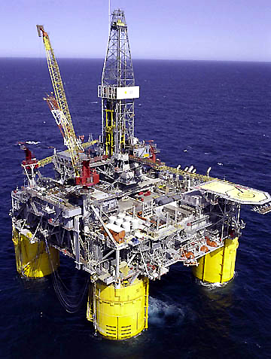
Which Sector???
PRIMARY

Slide 44
Which Sector???
TERTIARY

Slide 45
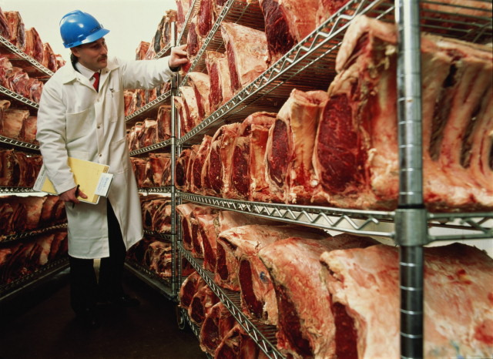
Which Sector???
SECONDARY

Slide 46
Which Sector???
QUARTERNARY

Slide 47
Social Indicators of Development
More developed countries use part of their greater wealth to provide schools, hospitals, and welfare services.
In turn, this well-educated, healthy, and secure population can be more economically productive.

Slide 48
Student-Teacher Ratios
Fig. 9-5: Students per teacher, primary school level. Primary school teachers have much larger class sizes in LDCs than in MDCs, partly because of the large numbers of young people in the population (Fig. 2-15).

Slide 49
Persons per Physician
Fig. 9-6: There is a physician for every 500 or fewer people in most MDCs, while thousands of people share a doctor on average in LDCs.

Slide 50
Calories per Capita
Fig. 9-7: Daily available calories per capita as percent of requirements. In MDCs, the average person consumes one-third or more over the required average minimum, while in LDCs, the average person gets only the minimum requirement or less.

Slide 51
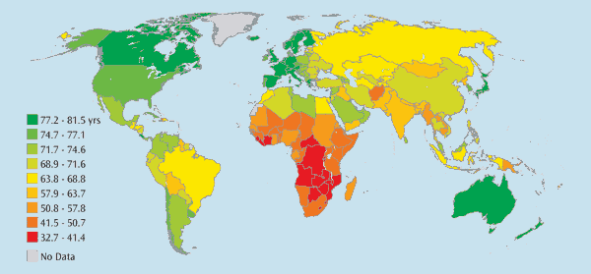
Demographic Indicators of Development - Life Expectancy

Slide 52
Other demographic characteristics that distinguish more and less developed countries include infant mortality, natural increase, and crude birth rates.
Babies born today can expect to live into their early forties in less developed countries compared to their mid-seventies in more developed countries.
The gap in life expectancy is greater for females than for males.
With longer life expectancies, MDCs have a higher percentage of elderly people who have
retired and receive public support.

Slide 53
Infant Mortality Rate
About 90 percent of infants survive. . . in less developed
countries, whereas in MDCs more than 99 percent survive.
The infant mortality rate is greater in the LDCs for several reasons: . . . malnutrition or lack of medicine. . . (or) poor medical practices.

Slide 54
Natural Increase Rate
The natural increase rate averages more than 2 percent annually in less developed countries and less than 1 percent in more developed ones.
Greater natural increase strains a country’s ability to provide services that can make its people healthier and more productive.

Slide 55
Crude Birth Rate
Less developed countries have higher natural increase rates because they have higher crude birth rates.
The annual crude birth rate exceeds 40 per 1,000 in many LDCs, compared to less than 15 per 1,000 in MDCs.
More developed and less developed countries both have annual crude death rates of about 10 per 1,000.
Two reasons account for the lack of difference.
First, diffusion of medical technology. has eliminated or sharply reduced the incidence of several diseases in less developed countries.
Second, MDCs have higher percentages of older people.
The mortality rate for women in childbirth is significantly higher in LDCs.

Slide 57
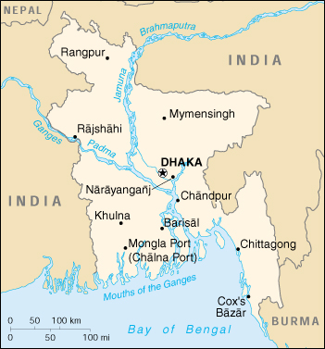
Tell me about Bangladesh…

Slide 58
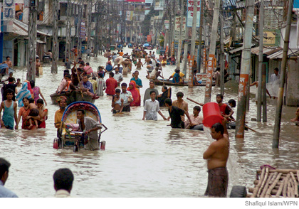
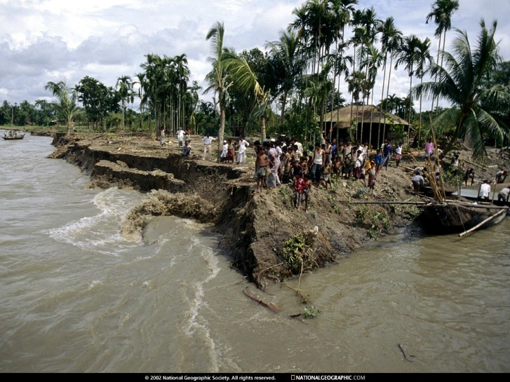
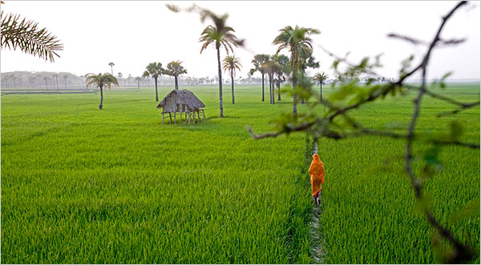

Slide 59
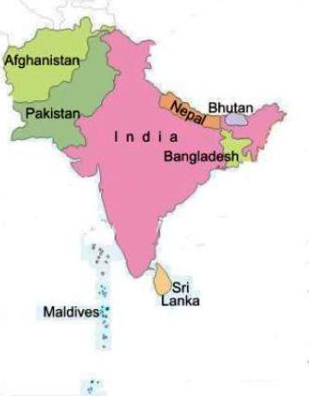
Bangladesh = Connecticut
Connecticut: pop. 3.5 million; avg. annual income over $45,000; literacy @95%; life span: 75; Infant mort.: 7/1000
Bangladesh: 120 mil; income: $220, literacy: 27%; avg. life: 55; Infant mort.: 115/1000

Slide 60
Bangladesh
One of the world’s poorest countries.
Stage Two developmental level (not adv.)
Stage Two population growth (fast!) – population growing faster than economy
Survives because there is adequate water (monsoon, rivers) and very fertile soil. Subsistence farmers can produce enough calories to survive

Slide 61
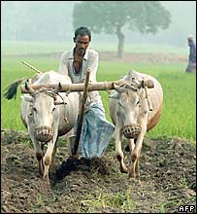
Rich v. Poor
What has Connecticut done so well to live at such a high level and what has Bangladesh not done well to struggle so?

