Slide 1
Mapping the Linguistic Peculiarities of American English
If language is the glue that holds cultures together, then examining the United States through that lens makes a complicated mess of traditional ways we divide up the country to generalize: whether it’s east versus west, north versus south, or, increasingly blue state versus red state.
A mapping project by statistics Ph.D. student Joshua Katz at North Carolina State University takes a visual look at significant differences in pronunciation and word choice that extend across the country, by plotting responses from more than 100 survey questions about dialectical variation on a heat map

Slide 2
Browsing the maps shows how many of the differences--and similarities--in the dialectical landscape are rather unexpected. In some cases, New Englanders have far more in common with Southerners than the rest of the country: both regions favor long ‘a’ sounds in the word ‘pajamas’ (where the second syllable sounds like ‘father’ as opposed to jam’), for example. Certain trends pit the coastlines against the interior, like soda versus pop, respectively. Other words, like ‘pecan’ have so much variation across the country, the entire map shows up in pale pastels, indicating no dominating trends in pronunciation. And can someone please explain why the only two states in the country where people consistently refer to a water fountain as a bubbler are Rhode Island and Wisconsin?
The reality presented on the maps simultaneously shows that we’re all a lot more similar than we think--no matter where we live--but also, freakishly different. “I’ve always found variations in dialect fascinating--language says so much about who a person is,” Katz told Abstract. “To me, dialect is a badge of pride--it’s something that says, ‘This is who I am; this is where I come from.’”

Slide 3
What do you call a long sandwich that contains cold cuts, lettuce, etc.?

Slide 4
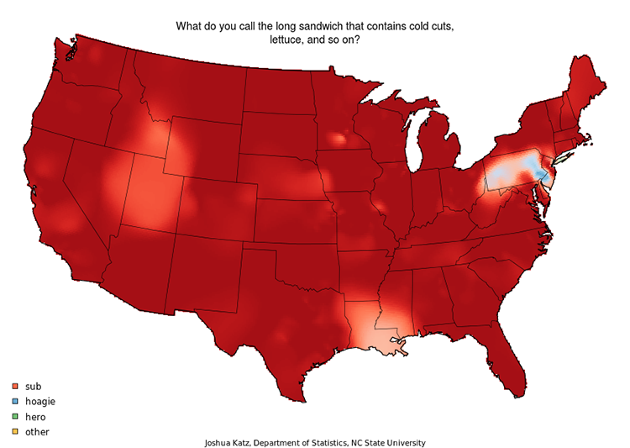

Slide 5
What words do you use to address a group of 2 or more people?

Slide 6
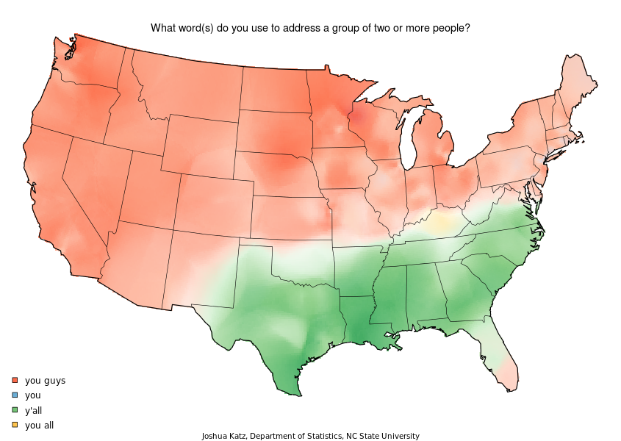

Slide 7
What do you call a traffic situation in which several roads meet in a circle and you have to get off at a certain point?

Slide 8
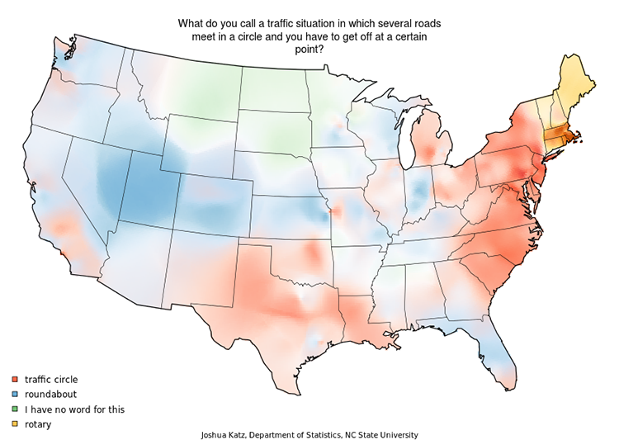

Slide 9
What is “the city?”

Slide 10
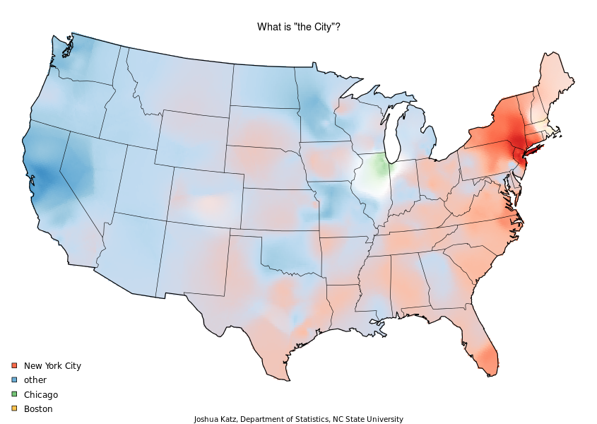

Slide 11
What is your general term for the rubber-soled shoes worn in gym class or for athletic activities?

Slide 12
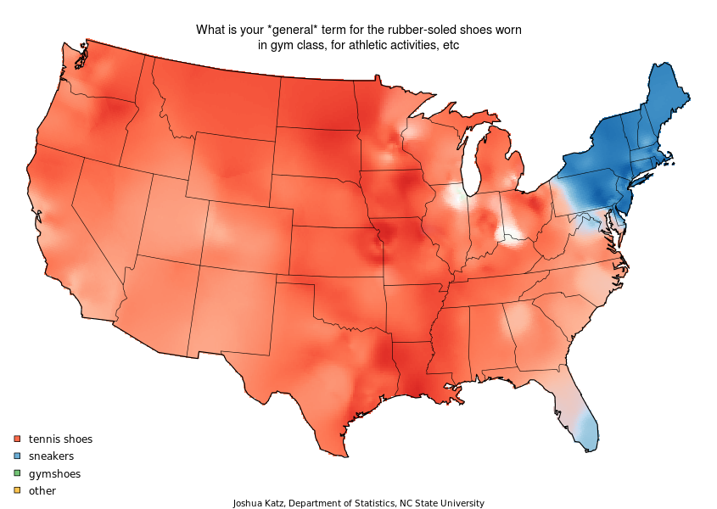

Slide 13
What is your general term for a big road you can drive relatively fast on?

Slide 14
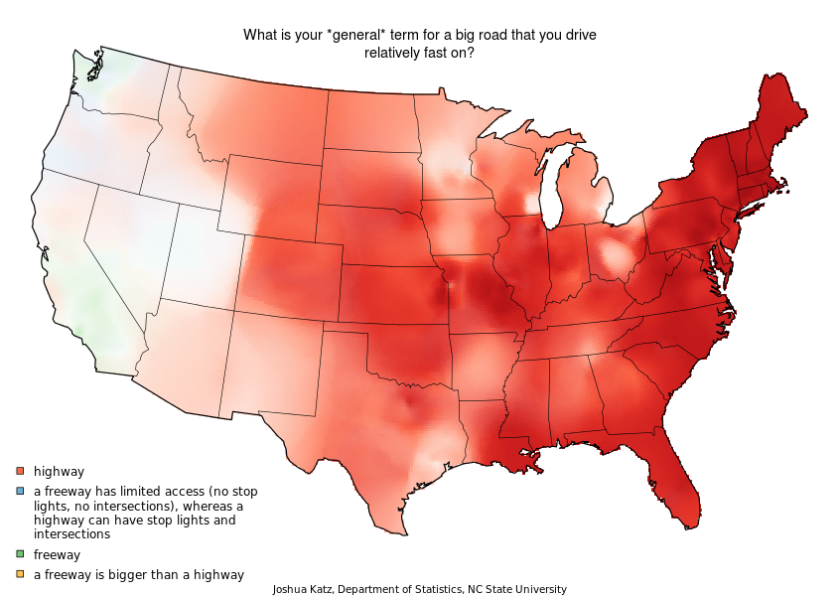

Slide 15
What do you call the thing from which you drink water from in a school?

Slide 16
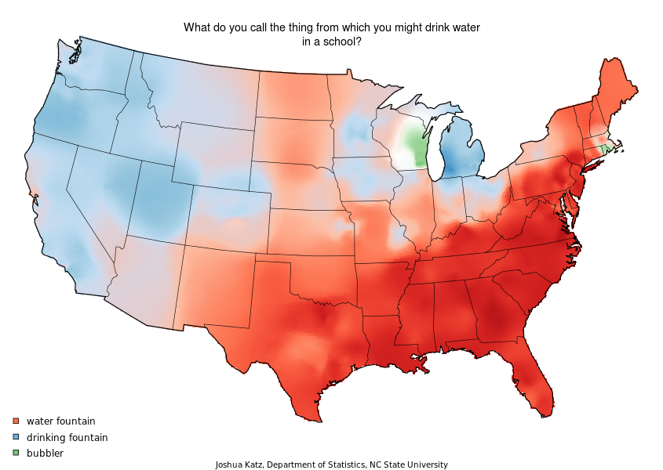

Slide 17
What is your generic term for a sweet carbonated beverage?

Slide 18
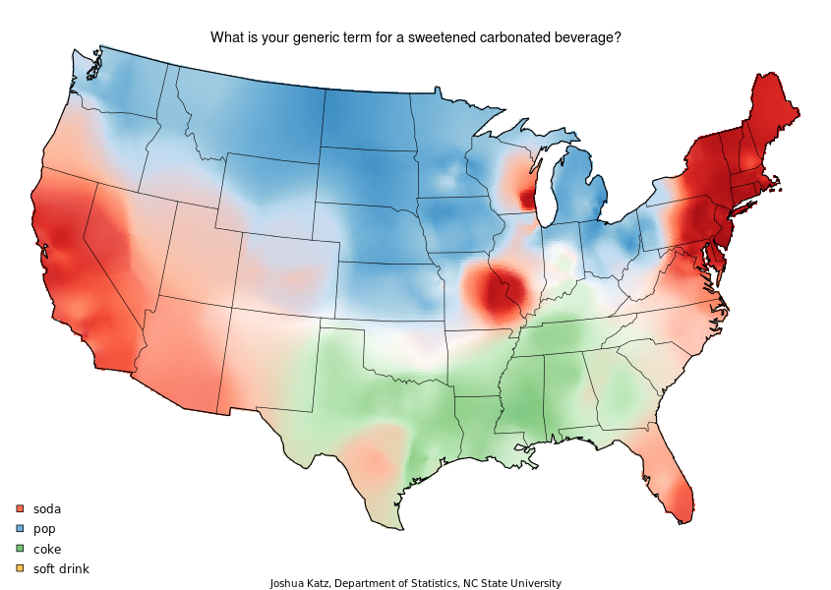

Slide 19
How do you pronounce “pecan?”

Slide 20
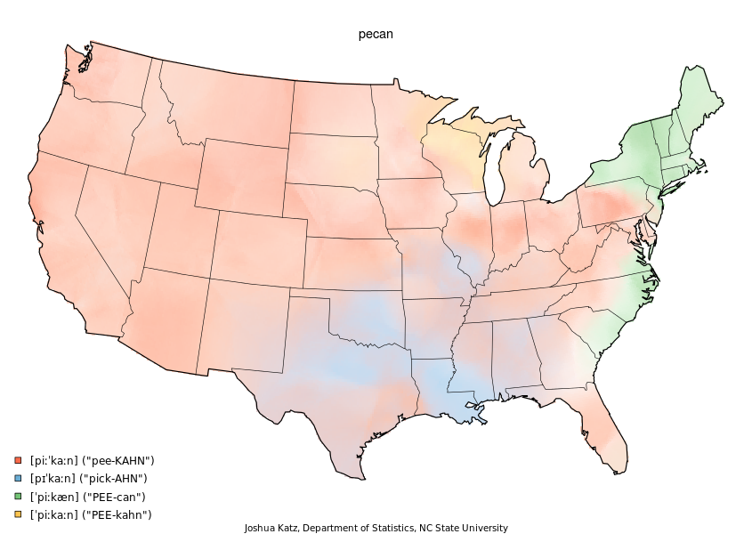

Slide 21
How do you pronounce “caramel?”

Slide 22
