Slide 1
MDC vs. LDC

Slide 2
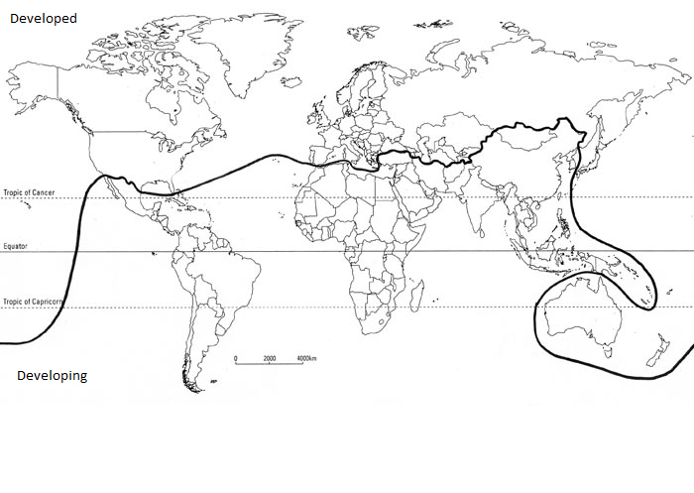
Draw and label this map
Brandt Line

Slide 3
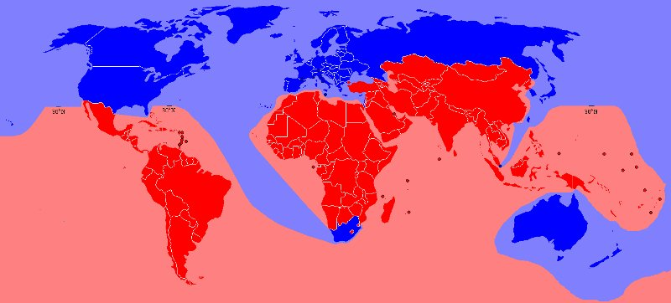
What differences do you notice between this map and the one we drew on our map?

Slide 4
More developed regions
Anglo-America
Eastern Europe
South Pacific
Western Europe
Japan
Less developed regions
Latin America
Southeast Asia
South Asia
East Asia
Middle East
Sub-Saharan Africa

Slide 5
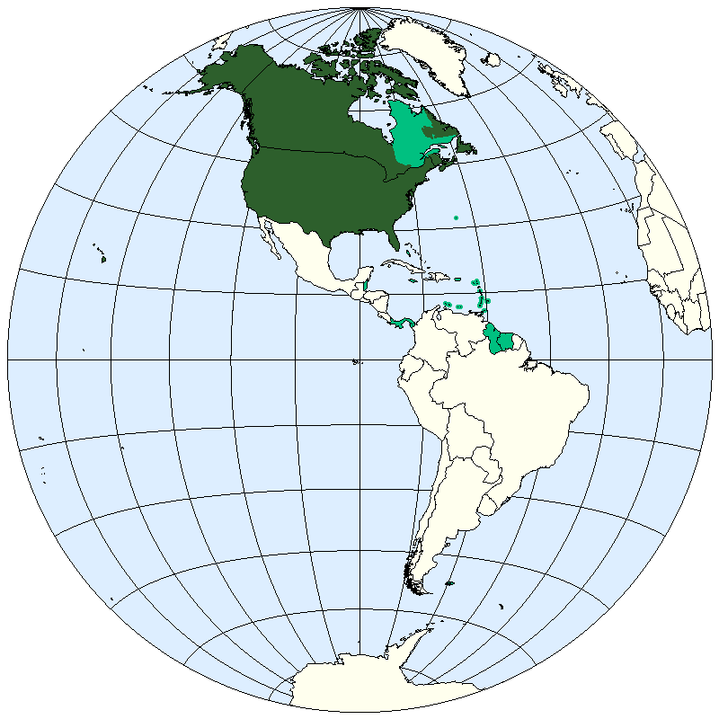
More Developed Regions –
Anglo-America
Language and religious patterns are less diverse in Anglo-America than in other world regions.
Cultural diversity generates some tensions in the region.
However, Anglo-America’s relative homogeneity reduces the possibility that a large minority will be excluded from participating in the region’s economy on the basis of cultural characteristics.
Anglo-America was once the world’s major producer. . . but in the past quarter century Japan, Western Europe, and less developed countries have eroded the region’s dominance. Americans remain the leading consumers.
The region has adapted relatively successfully to the global economy, in part because it is the leading provider of high-tech services and services that promote use of leisure time.

Slide 6
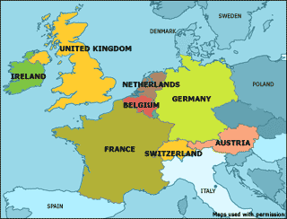
Western Europe
On a global scale, Western Europe displays cultural unity.
However, the diversity of individual languages and religious practices has been a longtime source of conflict, especially when strong national identities were forged.
Competition among Western European nationalities caused many wars.
Since the end of World War II. Western Europe has become much more unified.
Offsetting the increased cultural unity is migration of Muslims and Hindus in search of jobs.
Immigrants are responsible for much of the region’s population growth, and they have become scapegoats for the region’s economic problems. Within Western Europe the level of development is the world’s highest in a core area.

Slide 7
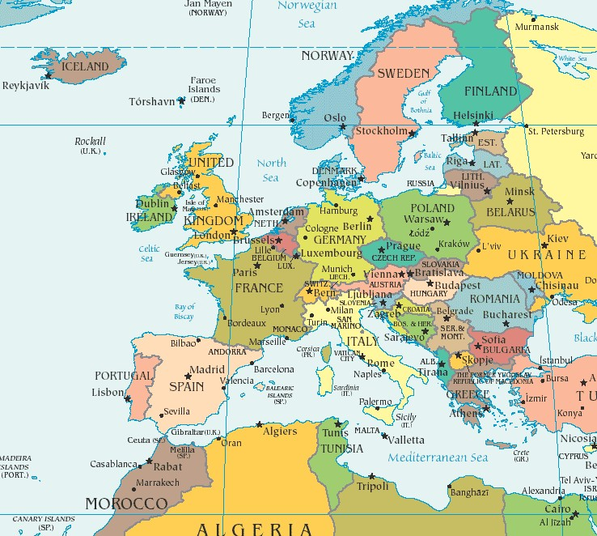
Western Europe Continued
Because the region’s peripheral areas—southern Italy, Portugal, Spain, and Greece—lag somewhat in development, Western Europe as a whole has a slightly lower development level than Anglo-America.
To maintain its high level of development, Western Europe must import food, energy, and minerals.
Colonies on every continent supplied many resources needed to foster European economic development.
Colonization also diffused Western European languages, religions, and social customs worldwide.
Now that most colonies have been granted independence, Western Europeans must buy raw materials from other countries.
To pay for their imports, Western Europeans provide high- value goods and services.
The elimination of most economic barriers within the European Union makes Western Europe potentially the world’s largest and richest market.
Most governments have been willing to sacrifice some economic growth in exchange for protection of existing jobs and social services.

Slide 8
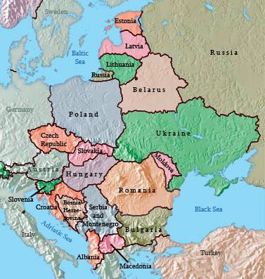
Eastern Europe
Eastern Europe has the dubious distinction of being the only region where the HDI has declined significantly since the United Nations created the index in 1990.
In 1990 Eastern Europe had an - HDI only slightly behind those of Western Europe and Anglo-America.
Eastern Europe’s rapidly declining HDI is a legacy of the region’s history of Communist rule.
Communist parties achieved rapid development, especially during the 1950s and 1960s.
Because few (Eastern European) states had modern industries the Communists had to apply their theories to poor, agricultural societies.
The Communists promoted development during the 1950s and 1960s through economies directed by government officials rather than private entrepreneurs.
In the Soviet Union, for example, a national planning commission called Gosplan developed five-year plans to guide economic development.

Slide 9
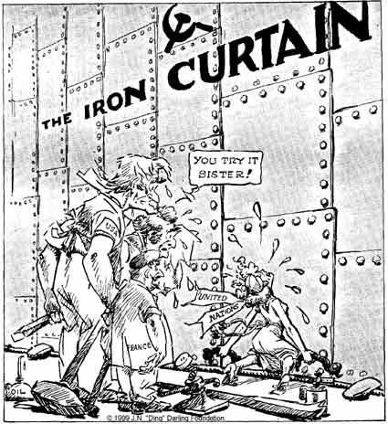
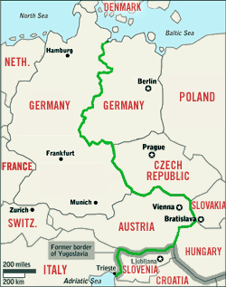
Eastern Europe Continued
The five-year plans featured three main development policies.
First—(emphasize) heavy industry, mining, electric power, and transportation.
Second—disperse production facilities. (Russia) had been (frequently) invaded from the west.
They wanted to reduce the vulnerability of their vital industries to attack, (and) to promote equal development throughout the country.
Third—locate manufacturing facilities near sources of raw materials rather than near markets. Soviet planners gave lower priority to producing consumer goods.
Eastern European countries in the 1990s dismantled the economic structure inherited from the Communists.
Aside from the desire for freedom, the principal reason that Eastern Europeans rejected communism was that central planning proved to be disastrous at running national economies.
For many Eastern Europeans, the most fundamental problem was that by concentrating on basic industry, the Communists neglected consumer products.
Although restricted from visiting Western countries, many Eastern Europeans could see on television the much higher level of comfort on the other side of the Iron Curtain.

Slide 10
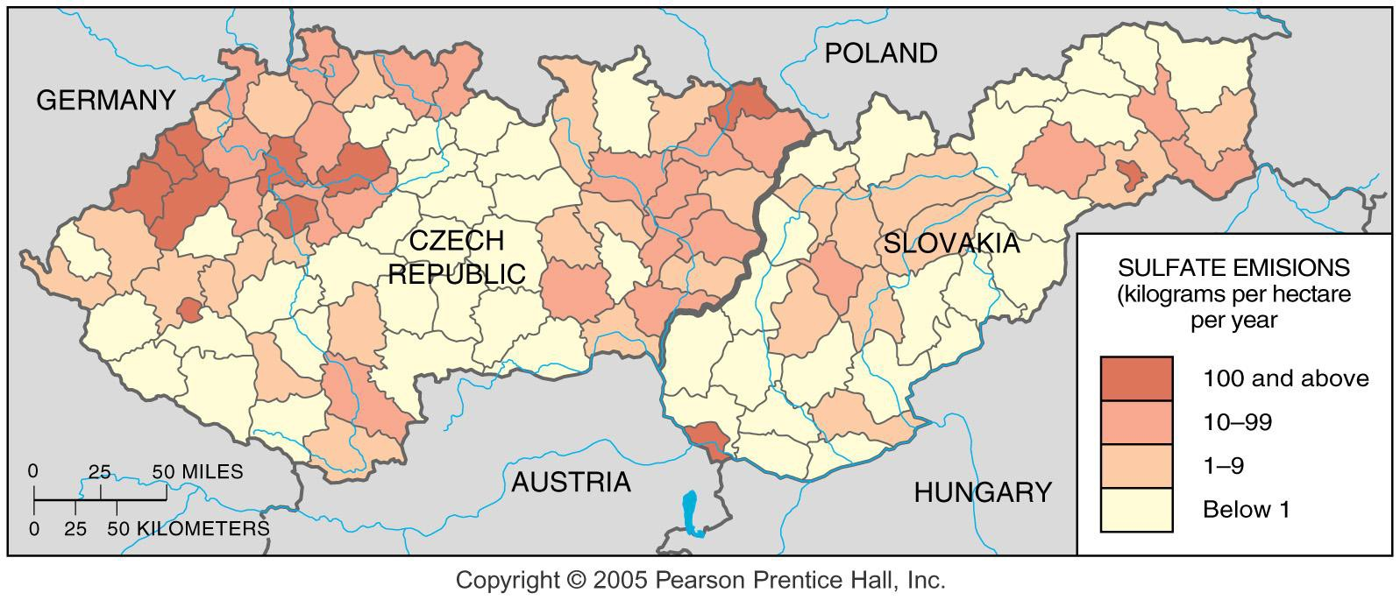
Air Pollution in Eastern Europe
Fig. 9-1-1: Sulfate emissions in the Czech Republic and Slovakia. GIS was used to map previously secret data on air pollution after the fall of the communist regime. Extremely high levels were found in some of the main industrial areas.

Slide 11
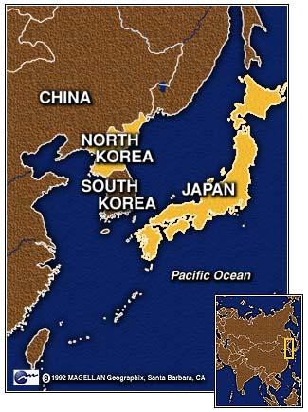
Japan
Japan, the third major center of development, has a different cultural tradition.
Japan’s development is especially remarkable because it has an extremely unfavorable ratio of population to resources.
The country has one of the highest physiological densities.
Although Japan is one of the world’s leading steel producers, it must import virtually all the coal and iron ore needed for steel production.
At first, the Japanese economy developed by taking advantage of the country’s one asset, an abundant supply of people willing to work hard for low wages.
Having gained a foothold in the global economy by selling low- cost products, Japan then began to specialize in high- quality, high-value products.
Japan’s dominance was achieved in part by concentrating resources in rigorous educational systems and training programs to create a skilled labor force.
The U.S. invested heavily in Japan after WWII and occupied it for 6 years, instituting a constitutional democracy and helped to rebuild the country.

Slide 12
Human Development Index (HDI)
An indicator of the level of development for each country, constructed by the UN, that is based on income, literacy, education, and life expectancy.
What do you think are the top 5 most developed countries, according to the HDI?
What do you think are the top least developed countries, according to the HDI?
http://hdr.undp.org/en/countries

Slide 13
Top 5 HDI Countries
Lowest 5 HDI Countries
Norway
Australia
Switzerland
Netherlands
United States
187. Niger
186. Democratic Republic of the Congo
185. Central African Republic
184. Chad
183. Sierra Leone

Slide 14
Emerging Developing Countries
BRIC-acronym coined in 2011 to include newly emerging developing economies
Brazil
Russia
India
China
The theory is that these countries will dominate the world economy by 2050

Slide 15
What characteristics do you believe should be factors to rate a country’s well-being?
OCED Better Life Index http://www.oecdbetterlifeindex.org/#/33215325331

