Slide 1
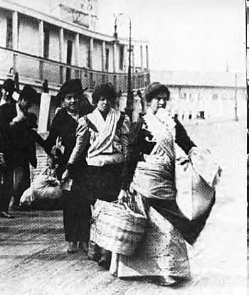
Migration Models
Zelinsky’s Model of Mobility Transition
Ravenstein’s Laws of Migration
Lee’s Migration Model
Don’t forget about Gravity and Distance Decay Models!

Slide 2
Population Change=
Fertility + Mortality + Migration

Slide 3
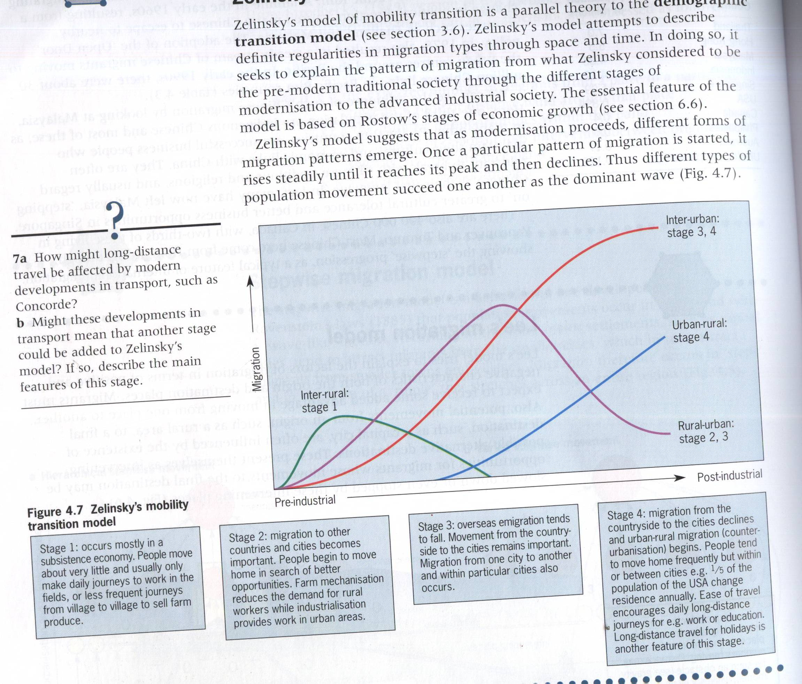

Slide 4
Zelinsky’s Model of Mobility Transition
Based on Rostow’s stages of economic growth/development
Phase 1 “Premodern traditional society”
Before onset of urbanization, very little migration. NIR around 0
Phase 2 “Early transitional society”
“massive movement from countryside to cities…as a community experiences the process of modernization.” Rapid NIR

Slide 5
Phase 3 “late transitional society”
Urban-to-urban migration surpasses the rural-to-urban migration. Rural-to-urban migration continues, but more circulatory movements within the urban network
Phase 4 “Advanced Society”
Movement from countryside to city continues, but not as much. More movement from city to city. Slight to moderate NIR
Phase 5 “Future superadvanced society”
Almost all migration interurban and intraurban

Slide 6
Zelinsky continued
International migration mostly occurs in countries in stage 2 of the demographic transition.
Why?
Internal migration occurs mostly in countries in stages 3 and 4 of the demographic transition.
Why?
How does the United States fit this pattern?

Slide 7
Ravenstein’s Laws of Migration (1870s-1880s)
1) Most migrants go a short distance.
2) People who migrate long distances tend to go to urban areas.
3) People already living in rural areas are more likely to migrate than those in urban areas.
4) Most migrants are adults. Women are more likely to migrate internally. Men are more likely to migrate internationally.
Do these laws fit with the immigration to the United States in the early 20th century?

Slide 8
Lee’s Migration Model (Push-Pull Model) 1940s
An attempt to explain the patterns of migration
Migration was a decision (individual or family) and depends on:
Characteristics of the origins
Characteristics of the destination
Nature of intervening obstacles (i.e. cost, borders, etc.)
Nature of the people

Slide 9
Push/pulls vary widely but economic is probably the most important
Potential migrants take into consideration a balance of the +’s and –’s of origin + destination along with difficulty of intervening obstacles in deciding whether or not to migrate

Slide 10
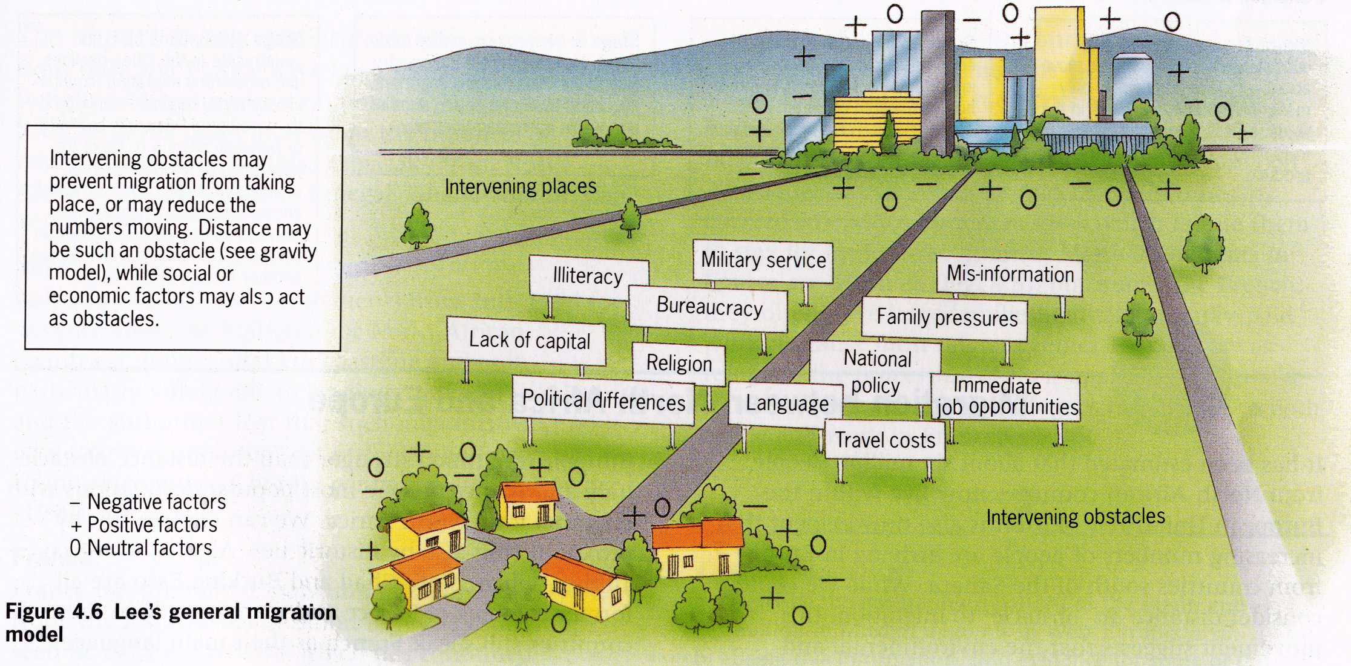
Lee’s General Migration Model
Source: Population, Resources and Development. Jane Chrispin and Francis Jegede. Collins Educational.1996.

Slide 11
Lee’s Migration Model
Real / Perceived
Intervening Obstacles
Location A
Location B
+
+
-
-
0
0
Does not isolate particular push and pull factors. Each site has a range of attributes. Different people will have different perceptions of the factors.
Intervening Place
?
+
-
0
Source: Adapted from Global Challenge. Alistair McNaught and Michael Witherick. Longman. 2001.

Slide 12
Constraints of Lee’s Behavioral Model
Does not account for the fact that some people have less ability to act on migration decisions
Only looks at people’s desire to act according to their assessment or desirability
People differ in their ability to act/migrate (no matter how desirable migration may seem)
i.e. poor people may not be able to migrate

Slide 13
Remember the Gravity Model!
Distance is a major obstacle
But it is too simplistic, does not account for other intervening factors, just distance
Attraction may be economic; obstacle may not be distance (i.e. borders)

Slide 14
Remember the Distance-Decay Model
The greater the distance, the less likely there is to be interaction or influence.
The lesser the distance, the more likely there is to be interaction or influence.
In terms of migration, people migrate to places that are closer.
Where do Cubans go that migrate to the United States?
Are immigrating Asians to the United States more likely to go to the west coast or the east coast?

Slide 15
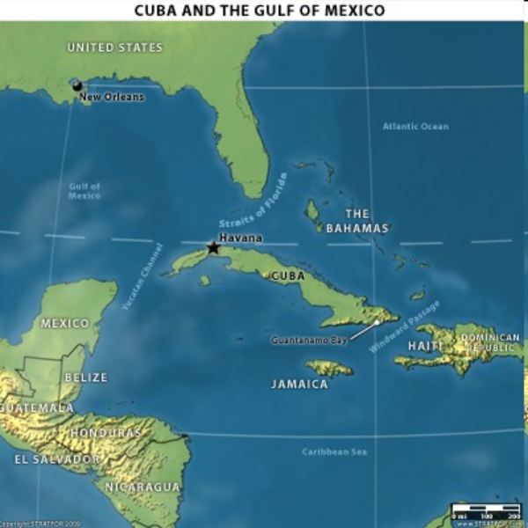

Slide 16
