Slide 1

Regional Geography
AP Human Geography
Key Issue 1.2

Slide 2
Regions
Basic unit of study in geography
  Dependent on scale
  No set regions
An area that is defined by one or more distinctive characteristics (government, language, landforms, situation, etc.)
Human constructs that can be mapped and analyzed
Maps are an essential tool for describing or revealing regions

Slide 3
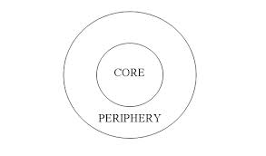
Core-Periphery
The core to a region is where vast amounts of people share the same trait
Once you move away from the core you get the periphery
  Influenced by other cores

Slide 5
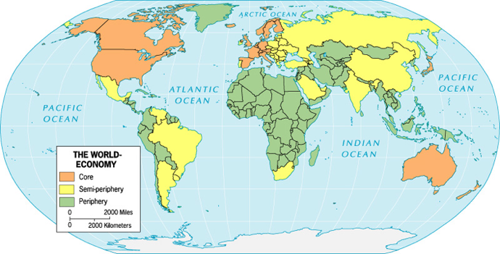
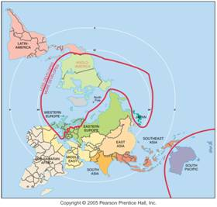

Slide 6
Culture trait- learned activities
  No two traits have the same distribution
  Religion and language very difficult to create a uniform region
  Territorial extents of a culture region depend on traits being used esp. in peripheral regions
Culture- how you do an activity

Slide 7
Major Types of Regions
Formal or Uniform region
  1 or more traits in common (religion, lang, econ practice, leisure activity, food)
  Must have boundaries
    Rarely sharp because of overlap
    Reveal a core where ALL defining traits are present
    Farther from core regional characteristics weaken then disappear
    Formal regions display core-periphery pattern
  Examples include countries, counties, etc.
  The point…the human world is chaotic

Slide 8
Functional or Nodal region
  An area organized around a node or focal point (fulfill a function politically, socially, economically, etc.)
      Ex: school district, church diocese, trade area
  Have nodes or central points from which functions are coordinated and directed
  Many have clearly defined borders
    Ex: States in the United States/Canadian Provinces
  Not all have clearly defined borders
    Ex: newspapers, sales area, fans of CU & CSU
  Generally do not coincide spatially with formal regions

Slide 9
Vernacular or Perceptual region
  Based on peoples’ perceptions
  A region perceived to exist by its inhabitants, has widespread acceptance and uses a regional name
  Generally lack sharp borders
  Can be based on:
    Physical environment
    Economic, political, historical aspects
    Often created by publicity campaigns
  Grows out of peoples’ sense of belonging and regional self-consciousness
  Examples: Middle East, the South, etc.

Slide 10
How do they differ?
Rooted in pop or folk culture
Lack organization necessary for functional regions
Unlike formal regions they frequently do not display cultural homogeneity

Slide 11
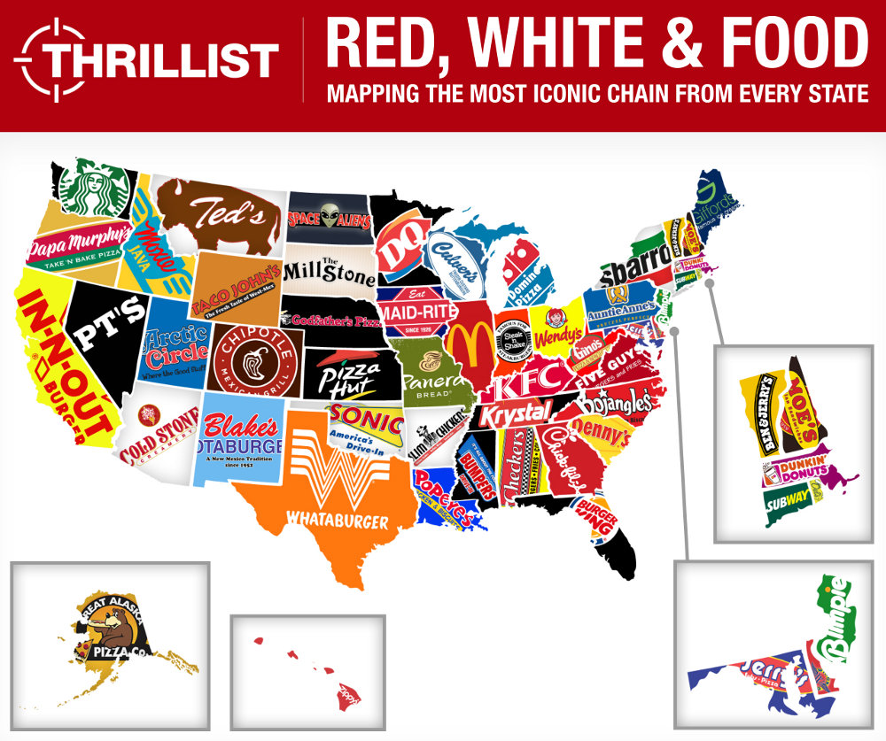

Slide 12
http://www.popvssoda.com/

Slide 13
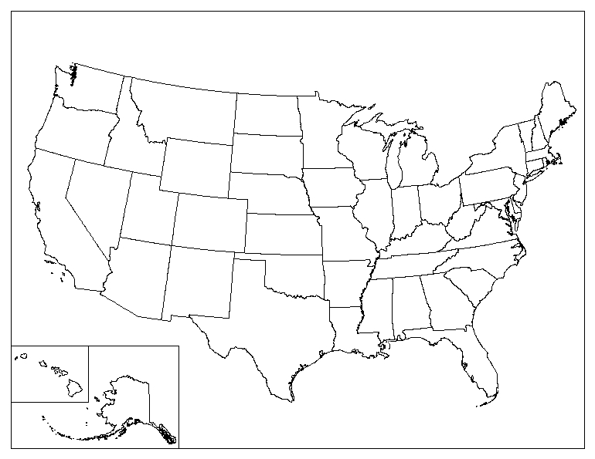
Mapping American Southwest: http://bcs.wiley.com/he-bcs/Books?action=resource&bcsId=5267&itemId=0470484799&resourceId=18408

Slide 14
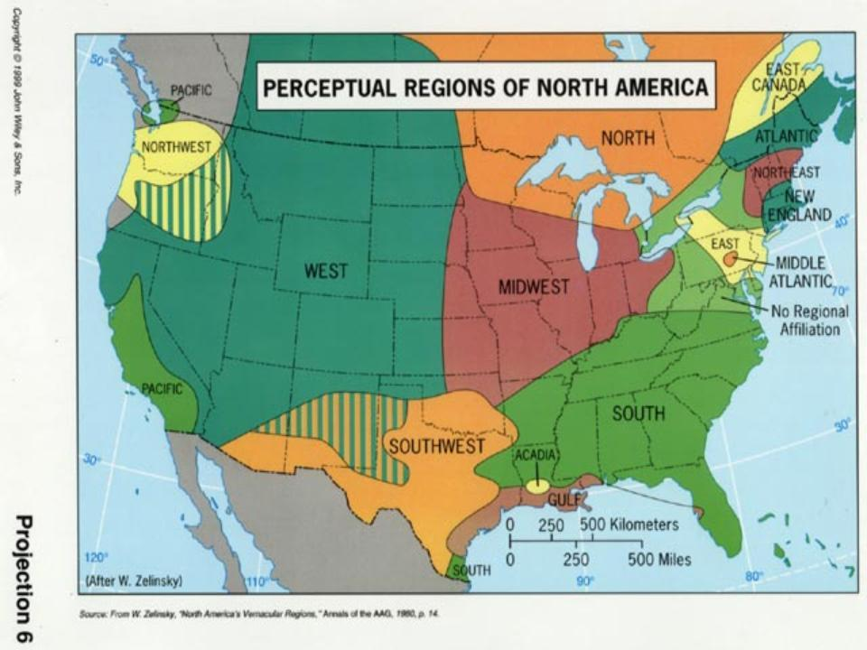

Slide 15
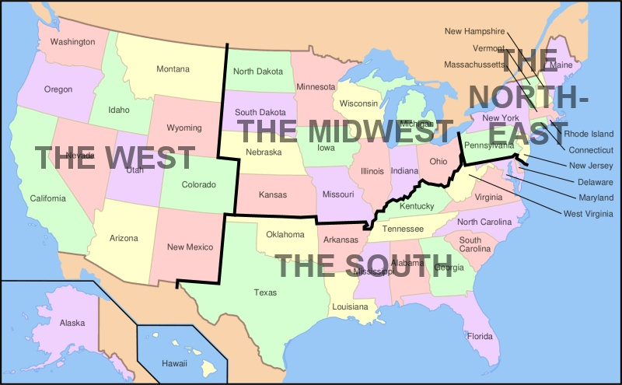

Slide 16
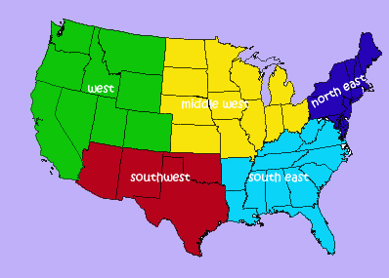

Slide 17
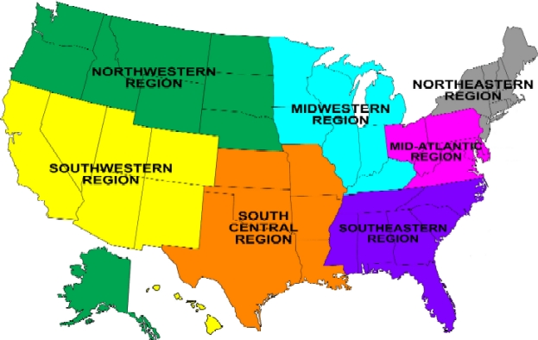

Slide 18
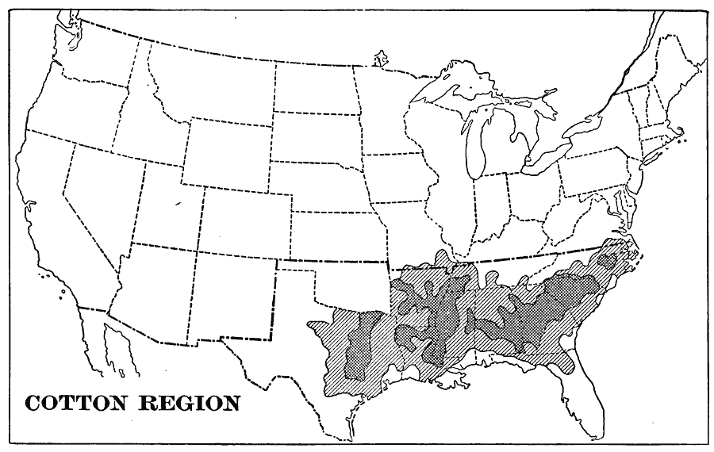

Slide 19
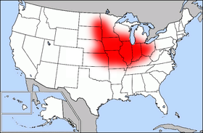
Corn Belt

Slide 20
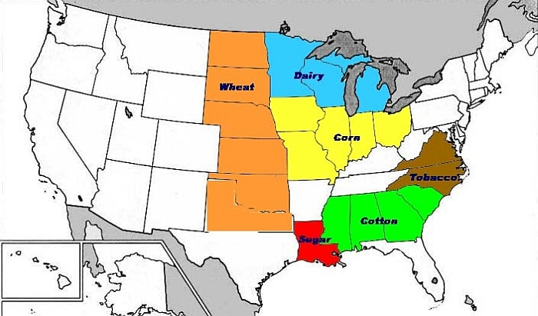

Slide 21
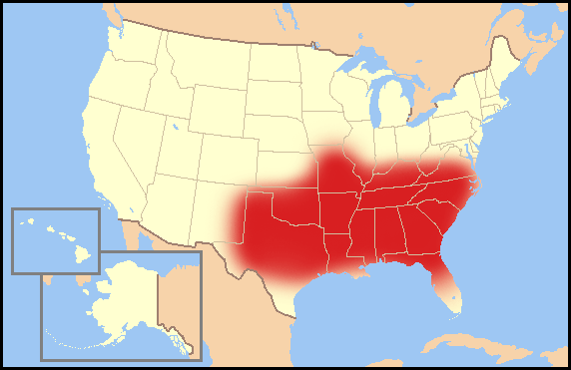
Bible Belt

Slide 22
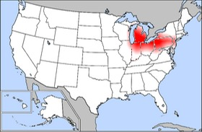
Rust Belt

