Slide 1
What is Geography?

Slide 2
Examine the following photographs.
How can they illustrate Geography in action?

Slide 3
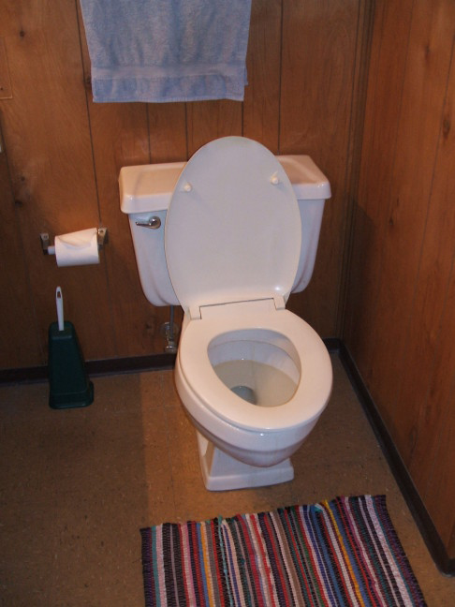
United States

Slide 4
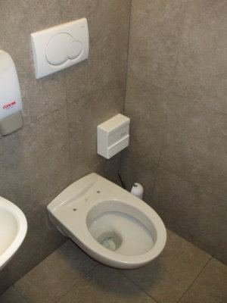
Italy

Slide 5
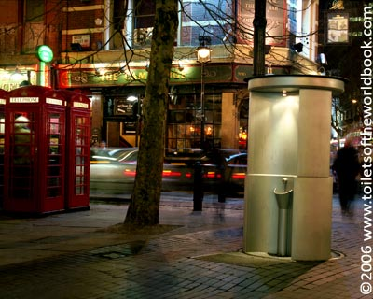
England

Slide 6
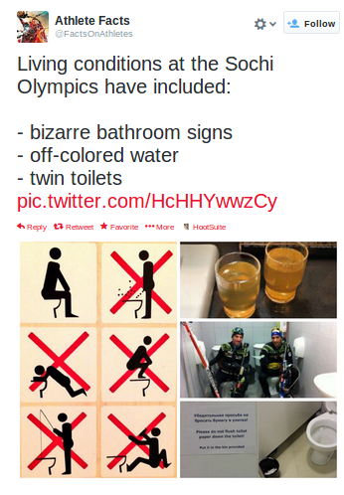
Russia

Slide 7
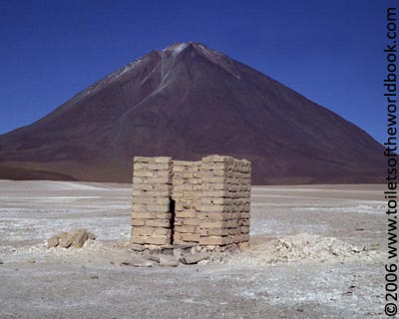
Bolivia

Slide 8
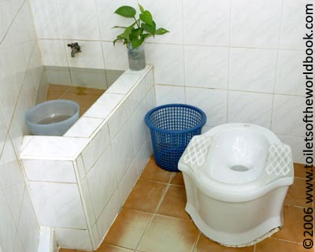
Thailand

Slide 9
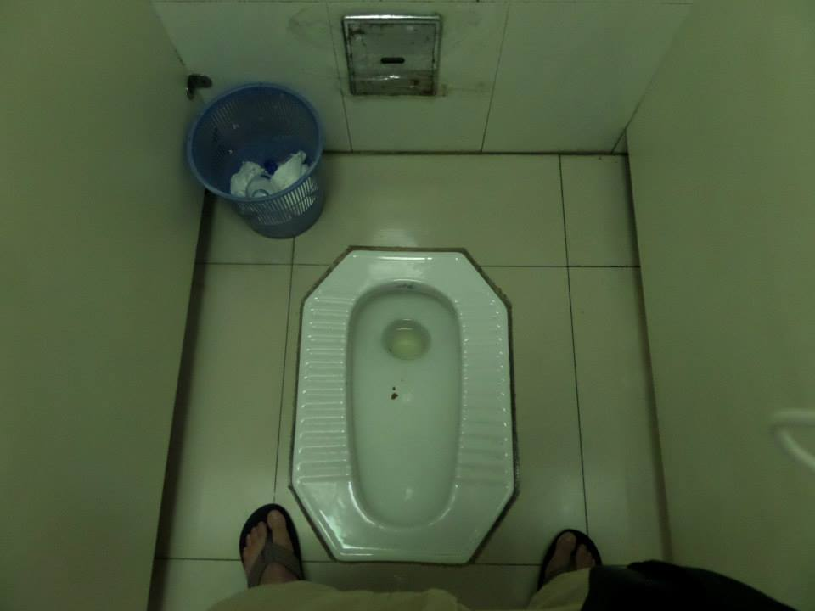
China

Slide 10
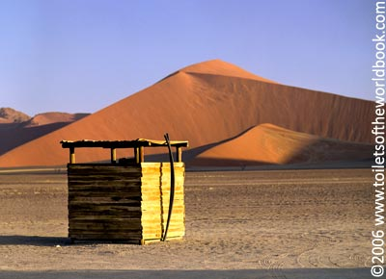
Nambia

Slide 11
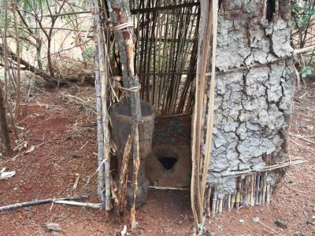
Ethiopia

Slide 12
Now…
What do these varying styles tell us about geography?
Hint: Think about anything but maps…

Slide 13
How are toilets geography?
Available resources: sustainability
Cultural ideas of sanitation and privacy
Development (MDC/LDC)
Language (Toilet, WC, Restroom)
Migration/Diffusion
Urbanization
Industries (bulk-gaining/bulk-reducing)

